Slide 1
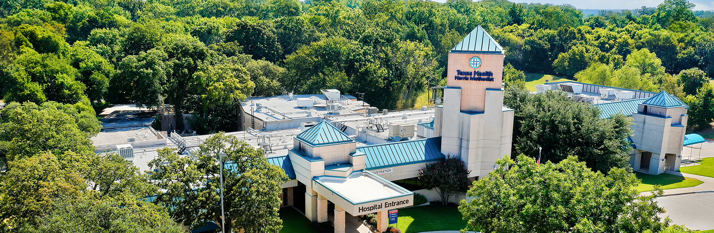
Reducing Visitor Falls Through Environmental Safety Improvements
Presented by Johan Vega-Ayala
Texas Health Harris Methodist Azle
Azle, Texas 76020

Slide 2
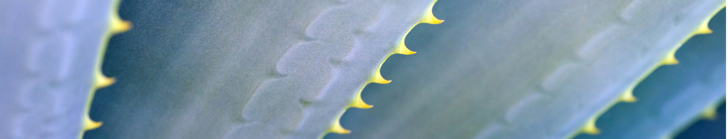
Project Purpose
To reduce visitor falls in the hospital parking lot and pedestrian pathways through targeted environmental safety improvements.

Slide 3
Our Safety Challenge
Analysis of safety event reports identified recurring falls in exterior campus areas.
Last 15 months:
14 documented falls
Average of ~1 fall per month
85% outside the facility
77% age 65+
62% occurred in parking lot/main entrance areas
Common Themes Identified
Concrete walking surfaces
Elevation changes
Stairways
Sloped Pathways
High pedestrian traffic areas
Project Context and Data

Slide 4
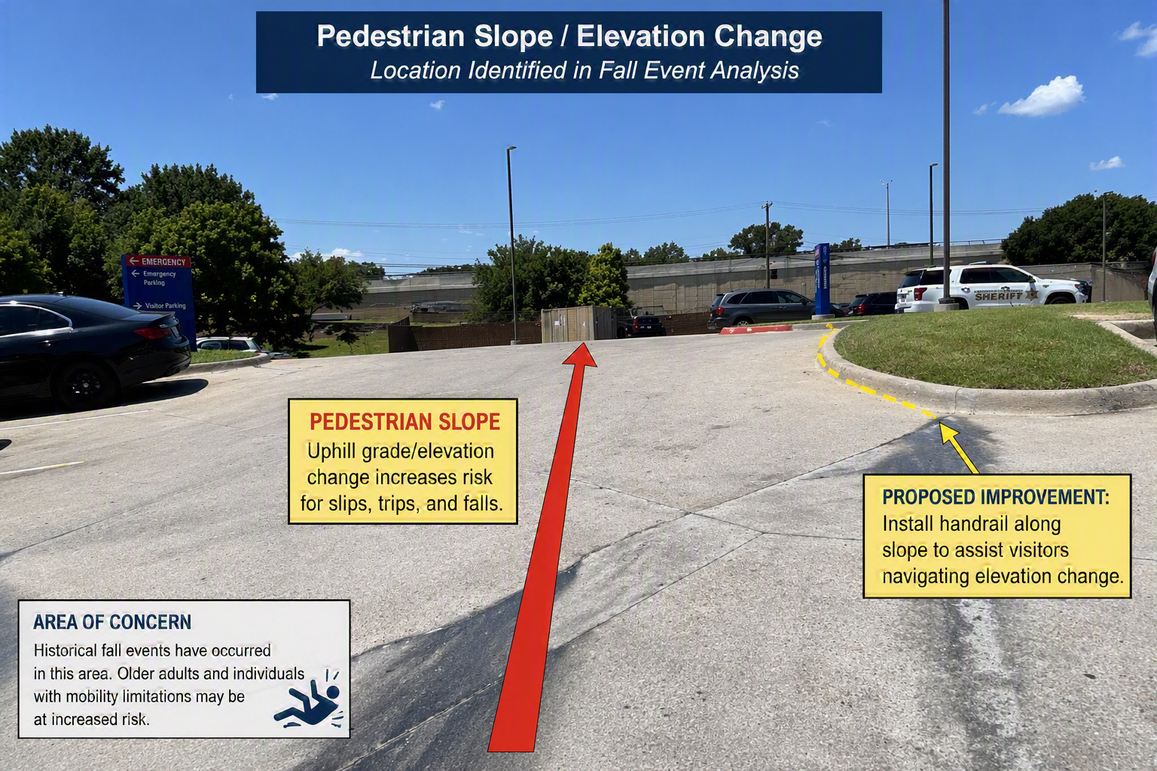

Slide 5
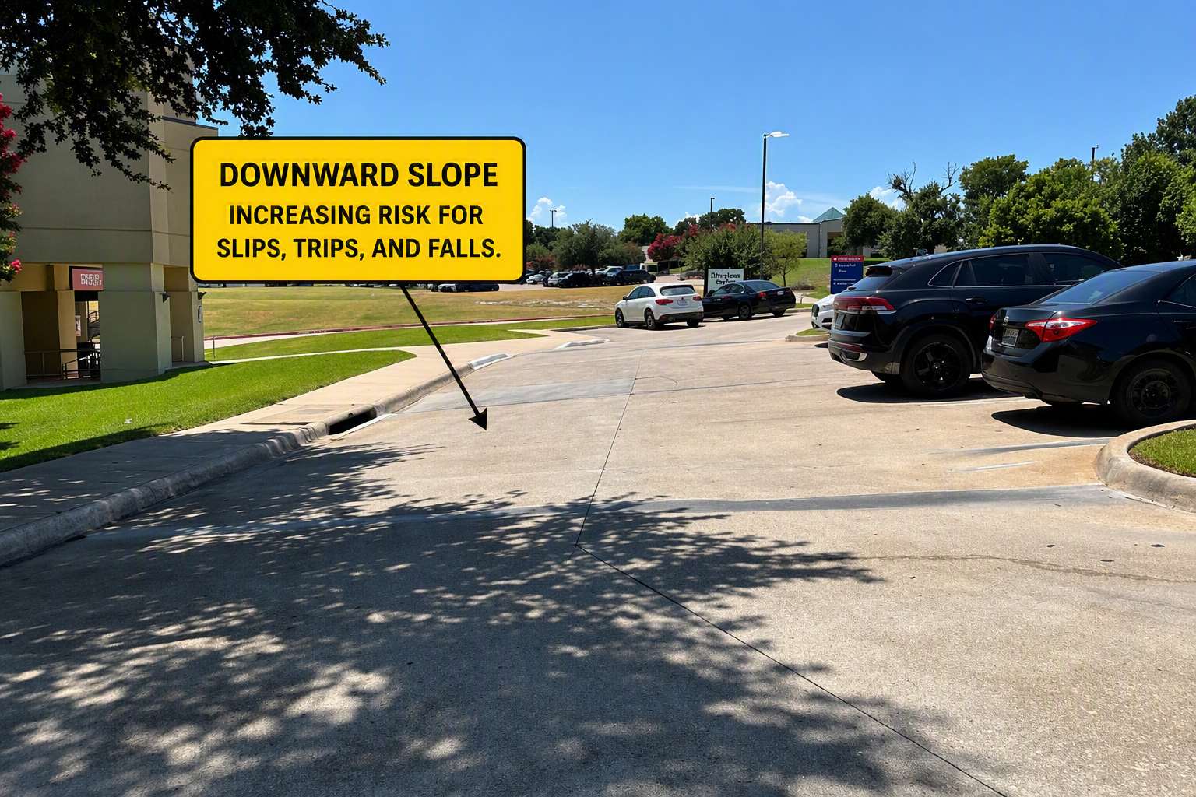

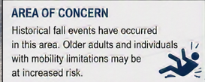

Slide 6
Where do we go from here?
Proposed Improvements
1. High Visibility Crosswalk
2. Handrail Along Sloped Sidewalk
3.Add Pedestrian Crossing Signs and Reflective Pavement Markings
4.Install a visitor rest bench to reduce fatigue-related falls.

