Slide 1


2026 AEIX Lighthouse Award Submission
Advancing Patient Safety Through Systemwide Language Access Transformation

Slide 2
Why Language Access Matters
Communication is a Patient Safety Imperative
Patients with Limited English Proficiency (LEP) are at increased risk for:
Communication-related medical errors
Delays in diagnosis and treatment
Longer hospital stays
Avoidable readmissions
Poor understanding of discharge instructions
Adverse health outcomes
Our Commitment
Every patient deserves safe, equitable, and understandable care regardless of language preference or communication needs.

Slide 3
Recognizing the Risk
Gap Analysis Findings
Challenges Identified
Inconsistent documentation of interpreter needs
Reliance on family members for interpretation
Limited interpreter availability
Restricted onsite language options
Scheduling barriers
Variable workflows across care settings
Limited access to interpreter equipment
Inconsistent Wi-Fi availability and connectivity
Patient Safety Risks
Communication breakdowns
Misunderstanding of care plans
Informed consent concerns
Increased risk of adverse events
Preventable readmissions
Regulatory and compliance vulnerabilities
Finding: Language access was not consistently available, visible, or embedded into care delivery across the health system.

Slide 4
A Systemwide Response
Riverside's Language Access Transformation
Resources
Comprehensive RFP process
New language services vendor
Expanded onsite and remote interpretation options
Education & Awareness
Leadership engagement
Frontline team education
Job aids and 24/7 intranet resources
Technology
Epic enhancements
Increased interpreter equipment
Language identification tools
IT ownership of equipment troubleshooting
IT engagement to monitor interpreter equipment, phones and iPads
IT initiative to enhance W-Fi capabilities across system
Governance
Oversight Committee
Standardized policies
Ongoing monitoring and accountability

Slide 5
Expanding Interpreter Access- Improved Availability & Performance
Measure | Previous State | Current State
Onsite Languages Available | 2 | 37
Languages Utilized | N/A | 26
Overall Fill Rate | 88% | 97.64%
Requests Filled Within 24 Hours | N/A | 95%
American Sign Language Fill Rate | 67% | 92.87%
Patients now have significantly greater access to timely, qualified interpretation services throughout Riverside Health.

Slide 6
Leveraging Technology to Improve Care
Making Language Access Easier for Care Teams
Increased Access
Deployment of 150+ interpreter iPads and carts
Expanded availability in inpatient, outpatient, urgent care, and ambulatory settings
Epic Enhancements
Interpreter needs displayed on patient storyboard
Visibility for all members of the care team
Outpatient Scheduling Improvements
"Needs Interpreter" field added to Daily Appointment Review dashboard
Improved proactive planning for interpreter services
Infrastructure Improvements
Dedicated network supporting interpreter technology and reliability

Slide 7
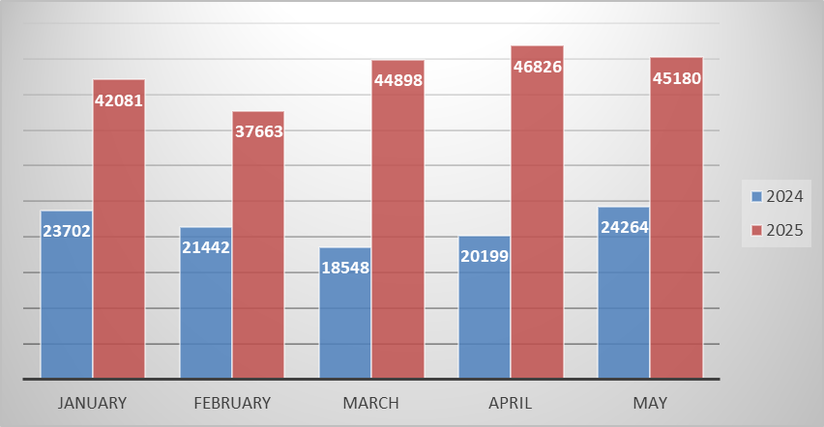
Demonstrating Success
Increased Utilization
Growth in professional interpreter use
Improved access for LEP patients
Decreased reliance on family members for interpretation
Workflow Improvements
Better visibility of interpreter needs
More consistent documentation
Streamlined scheduling and access processes
Financial Stewardship
Increased utilization of language services while reducing
overall costs
Enhanced Access
Expanded equipment deployment to over 150 locations
Consistent availability across previously underserved locations
Video and Audio Interpreter Usage

Slide 8
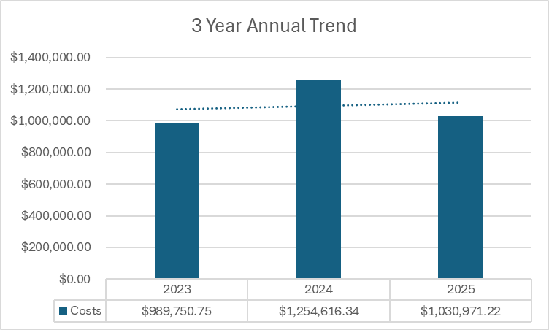
3 Year Annual Spend

Slide 9
Improving Patient Outcomes
Removing Communication Barriers Improves Care
Key improvements include:
Translation of patient-facing documents
Expansion of translated discharge instructions
Improved understanding of care plans
Better patient engagement and education
Example Success
Translated Postpartum discharge materials at Riverside Shore Memorial Hospital into Haitian Creole, one of the top languages in that community. The team partnered with the Language Access Team to have all patient education translated, and after implementing the newly translated documents this action contributed to improved communication and coincided with a reduction in readmissions related to postpartum patients returning due to adverse symptoms that could have been managed at home or earlier at their primary care physician's office.

Slide 10
Sustaining the Improvement
Language Access Oversight Committee
Responsibilities
Creation of system wide infrastructure to provide resources, education and feedback for sustainability
Assess and monitor the language needs of patients/residents/companions at the facility
Monitor and evaluate the effectiveness of language access initiatives and make necessary adjustments
Develop and recommend policies and procedures to improve access
Ensure compliance with applicable requirements
Promote cultural competency within the health system
Recommend and implement training and resources for staff
Ongoing Support
Weekly vendor collaboration meetings
Continuous performance monitoring
Organization-wide training and education
Leadership accountability

Slide 11
Looking Ahead
Continuing the Journey
Future initiatives include:
Qualified bilingual team member program
Additional Epic enhancements
Expanded document translation services
Innovative technology solutions
Continued outcome monitoring
Ongoing improvement in equitable care delivery
Our Vision
To ensure every patient receives safe, equitable, and person-centered care regardless of language or communication needs.

Slide 12
Language Access is a Patient Safety Imperative
Riverside Language Access Program
✅ Improved patient safety
✅ Reduced communication-related risk
✅ Enhanced regulatory compliance
✅ Increased access to qualified interpreters
✅ Improved workflows for care teams
✅ Expanded equitable access to care
✅ Established a sustainable systemwide model

