Slide 1


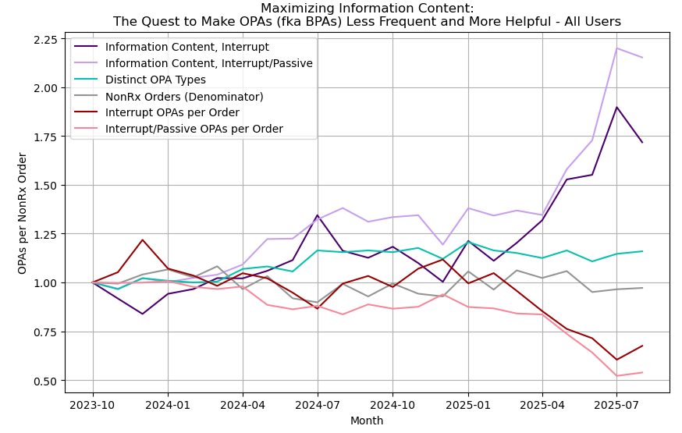
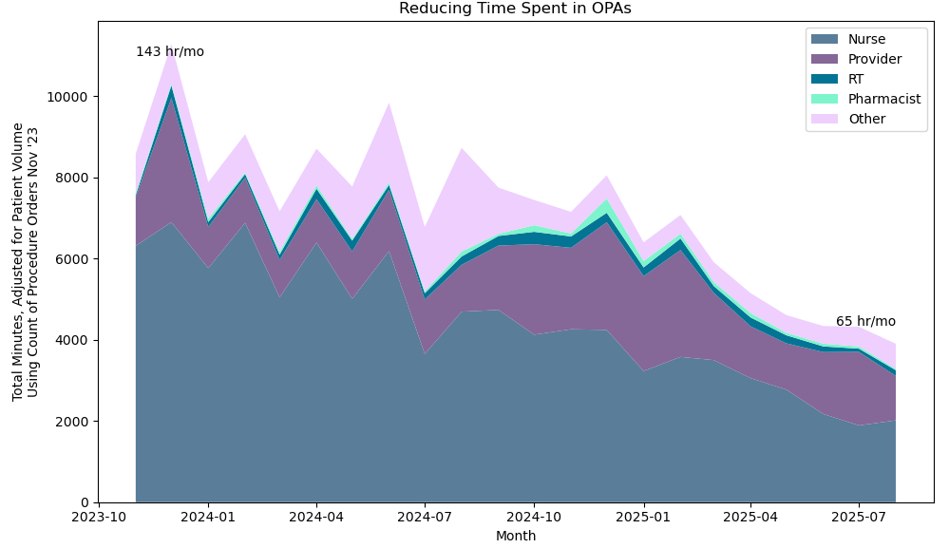
Reducing Alert Fatigue to Restore Joy in Work
Jacqueline Crouch, PharmD, BCPS, BCPPS, Michael Hart, PharmD, Michael Scahill, MD
Contact
Jacqueline Crouch, PharmD, BCPS, BCPPS Director, Quality, Patient Safety, & Infection Prevention Email: jschnee1@valleychildrens.org
Introduction
Clinical decision support (CDS) tools play a central role in guiding clinicians toward safe and effective care. Yet when alerts are overly frequent, redundant, or poorly designed, they contribute to alert fatigue. At Valley Children’s Healthcare, clinicians across disciplines reported workflow disruptions, decreased trust in alerts, and a diminishing sense of joy in work due to excessive OurPractice advisories (OPAs). In response, the organization initiated a collaborative redesign effort grounded in information theory, seeking to elevate alert value while reducing burden.
Results
Figure 1. The Journey to Less Frequent and More Helpful Alerts
Information Content Improvements
Interruptive information content increased sharply beginning mid-2024 and peaked in early 2025.
Combined interruptive and passive information content rose, demonstrating more targeted, actionable alerts.
Streamlining Alert Types
Distinct OPA types steadily decreased, indicating successful consolidation of redundant or low-value advisories.
Consistency Across Clinical Areas
Ordering volume remained stable, confirming that improvements were due to redesign, not changes in ordering behavior.
OPA Time Burden
55% reduction in total monthly OPA-related time (143 → 65 hours/month).
All clinical roles experienced meaningful decreases, with nurses showing the largest absolute reduction.
Objectives
To improve clinician well‑being and CDS effectiveness by: Reducing OPA volume and time burden Increasing the informational value of OPAs using information‑theory–based redesign Improving workflow efficiency across clinical roles
Methods
Create Team
Clinical Pharmacist
IT Analyst
Assess
Evaluate signal-to-noise ratio at baseline (October 2023)
Analyze
Reports drive targets
High volume
Redesign
Evaluate all aspects of alert build using 5 Rights of Clinical Decision Support
Monitor
Informatics Physician
Other Disciplines
(ad hoc)
Low “success”
Negative feedback
Evaluate ongoing signal-to-noise ratio and repeat analysis and redesign
Figure 2. Reducing Time Spent in OPAs
Conclusions
The redesigned OPA framework meaningfully improved the effectiveness and usability of clinical decision support at Valley Children’s Healthcare, demonstrating the value of applying information‑theory principles to alert optimization. These improvements directly support the core purpose of this work—restoring joy in work by reducing unnecessary cognitive load, minimizing workflow disruption, and enabling clinicians to focus more fully on patient care. Enhanced clinical relevance of alerts increased signal‑to‑noise and supported more confident decision‑making. Reduced workflow interruptions helped clinicians maintain task flow and reduced frustration associated with low‑value alerts. Improved clinician experience and trust emerged as redesigned alerts became more meaningful and less burdensome. A sustainable, scalable optimization model was established, allowing continued improvements across additional CDS domains and reinforcing long‑term clinician well‑being.
Key Takeaways
• Fewer alerts • Higher Information Value • Less Workflow Disruption • Stronger Clinician Trust • Enhanced Patient Safety
• More JOY in Work!
References | Fallon A, Haralambides K, Mazzillo J, Gleber C. Addressing Alert Fatigue by Replacing a Burdensome Interruptive Alert with Passive Clinical Decision Support. Applied Clinical Informatics. 2024. Eagen A. Alert Fatigue and Alert Override Significance in Relation to CDSS Success. Acta Scientific Medical Sciences. 2023; 7(5). Murad DA, Tsugawa Y, Elashoff DA, Baldwin KM, Bell DS. Distinct Components of Alert Fatigue in Physicians’ Responses to a Noninterruptive Clinical Decision Support Alert. Journal of the American Medical Informatics Association (JAMIA). 2022.

