Slide 1
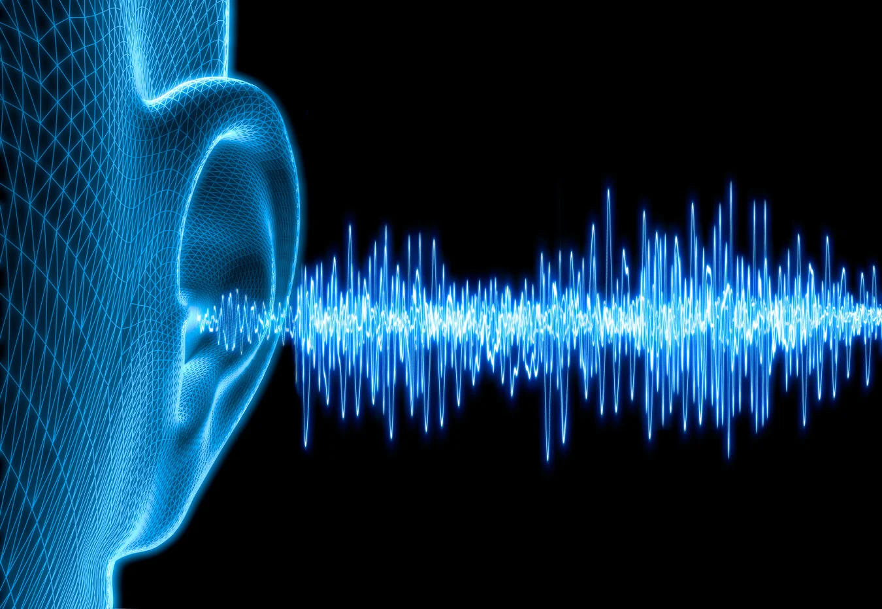
Sound Attenuation During MRI Exams
By: Melissa Kitzmiller, RT(R)(MR)(CT)(ARRT), BS Cognitive Science, AS Radiologic Science, AS Management Information Systems, AS Business Administration, Radiologic Technologist III, Magnetic Resonance Imaging Technologist I, Imaging Clinical Preceptor, Student Clinical Preceptor for Merced College and Fresno City College, Valley Children’s Hospital
Mentorship: Fred Laningham, MD; Bernette Orcutt, RT(R)(MR)(CT)(ARRT)

Slide 2
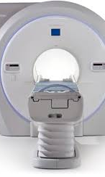
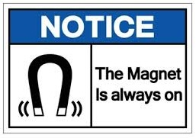
Sound Attenuation During MRI Exams
*MRI machines consist of a large cylindrical tunnel – bore – and a non-ferromagnetic couch or patient table.
^{*The magnet is ALWAYS on.}
*Three-dimensional cross-sectional images of anatomy allow visualization of adjacent structures without superimposition, through the use of image weighting.
Image weighting determines the contrast of an image. It is controlled through the parameters within each sequence.
*Although parameters can be adjusted by the technologist, it can affect image quality.
*Several Safety concerns exist in MRI.

Slide 3
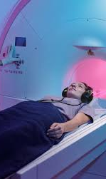
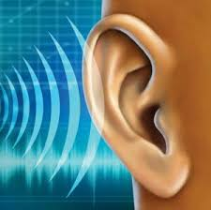
Sound Attenuation During MRI Exams
Sound is one of the most preventable safety risks in MRI.
During MRI Exams – patients within the bore or cylindrical tunnel of the machine experience several loud, repetitious sounds as the machine acquires images.
Prolonged exposure to loud, repetitious sound can cause permanent threshold shifts and hearing loss. ^{3, 4}
Sources of sound exposure in MRI-
^{+Machine noise - ColdHead}
+Gradient coil noise – rapid switching of gradients
+Sequence noise – Certain protocols exude louder
noise as the machine acquires images.

Slide 4
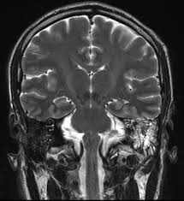
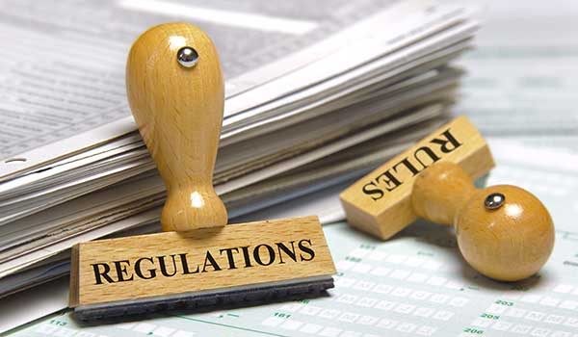
Regulatory Oversight
-OSHA -CalOSHA
-FDA -ISMRM
-CDC

Slide 5
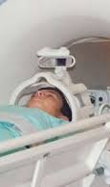
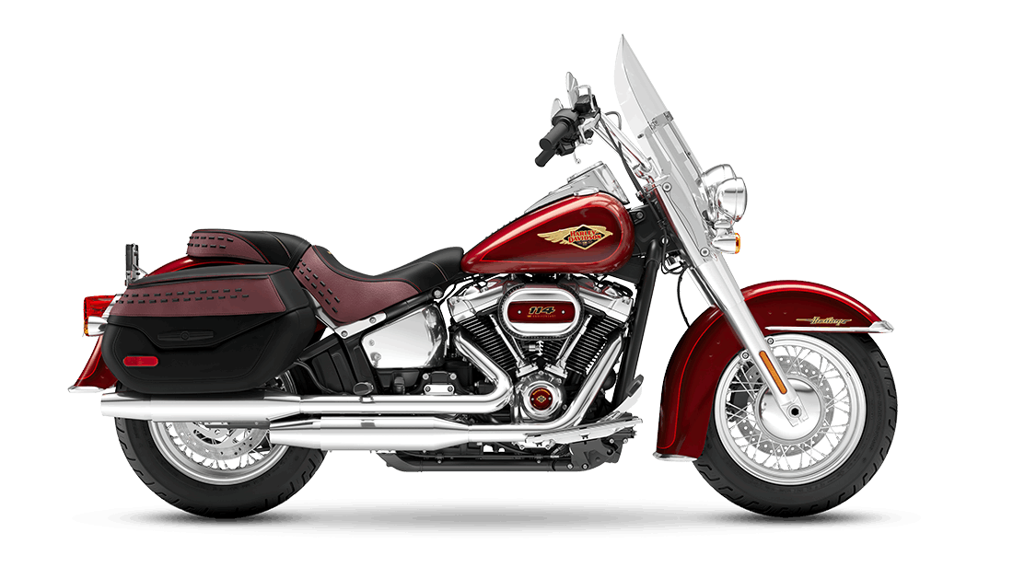
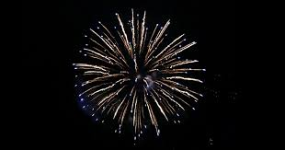
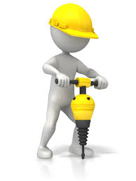
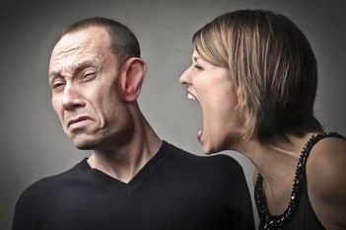
Normal Sounds and Their Intensity
Normal Breathing 10 dB
Soft Whispering 30 dB
Library 40 dB
Normal Conversation 60 dB
Doorbell 80 dB
Heavy Traffic (Inside Car) 85 dB
Shouted Conversation 90 dB
Motorcycle 95 dB
Hair Dryer 100 dB
Car Horn at 5 meters 105 dB
Shouting in Ear 110 dB
Standing near a Siren 120 dB
Jackhammer 130 dB
Airplane taking off 140 dB
Firecrackers 150 dB

Slide 6
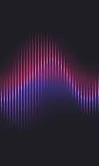
Sound Pressure Levels
T1 Gradient Echo 90.9 dB
T1 Spin Echo 104.8 dB
T2 Spin Echo 96.8 dB
FLAIR 94.0 dB

Slide 7
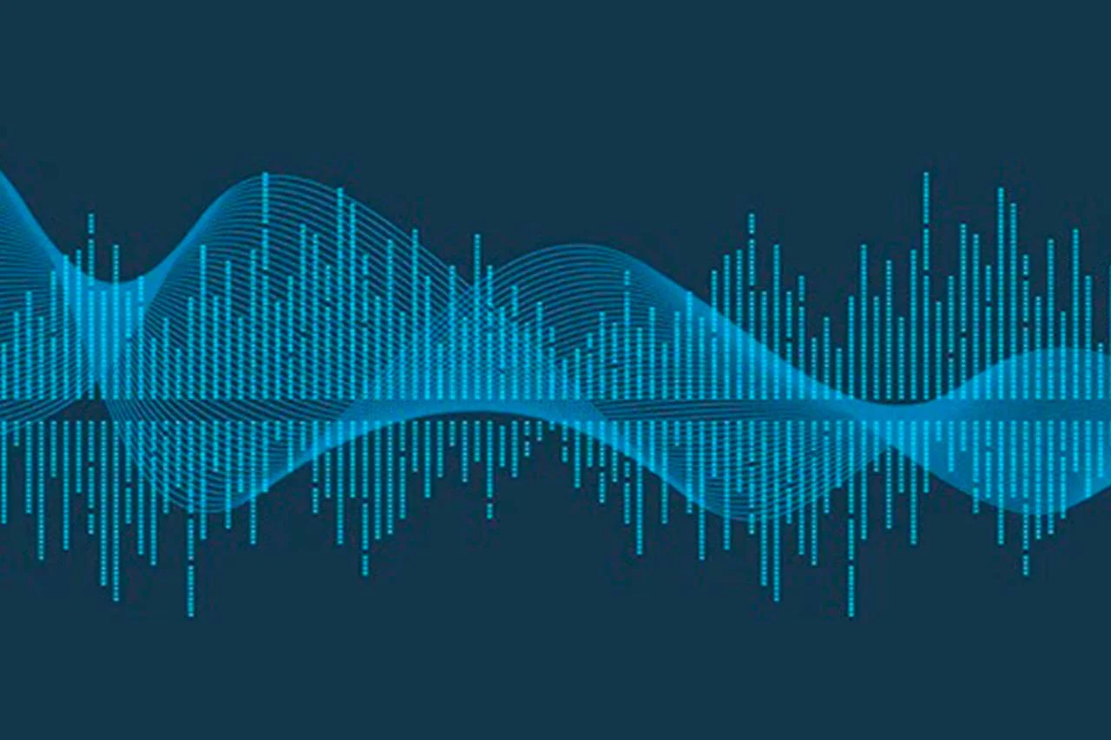
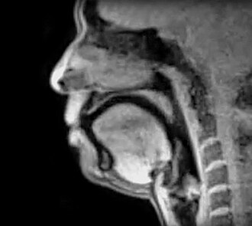
Sound Pressure Levels
Ambient scanner Noise 65 dB
Conventional Spin Echo 80 dB
Turbo Spin Echo 93 dB
Rapid Gradient Recalled Echo 105 dB
Echo Planar Imaging 127 dB
3D sequences (MPRAGE) 113 dB

Slide 8
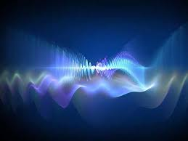
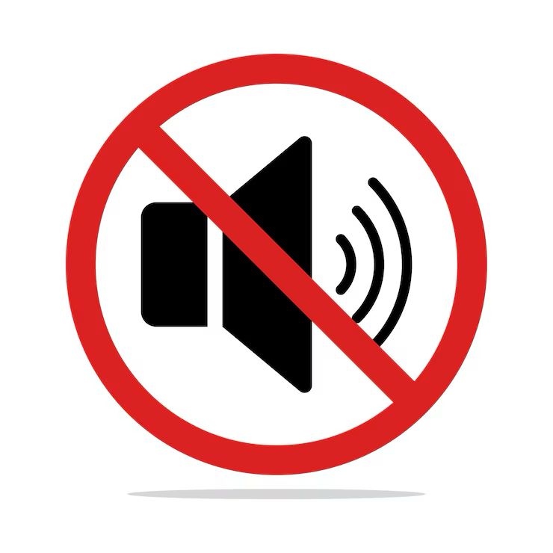
Sound Attenuation
A lessening in amount, force, magnitude, or value
-Merriam Webster Dictionary

Slide 9
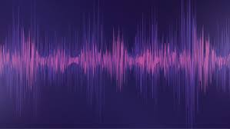
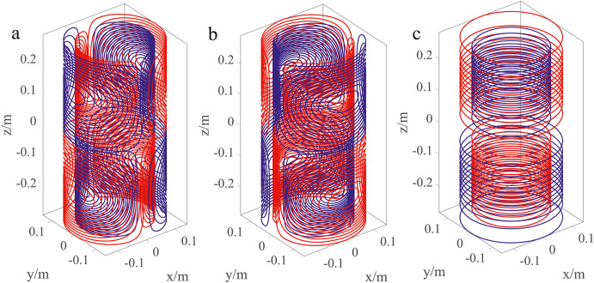
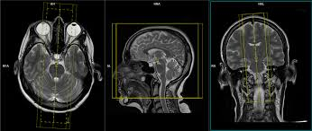
Sound Attenuating Solutions:
1. Gradient Coil Shape
2. Protocol Optimization
3. Hearing Protection

Slide 10






Gradient coil shape
→ Would be an important factor during the design phase of an MRI machine
→ Not practical as an everyday solution
→ Information can become very technical

Slide 11
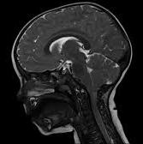
Protocol Optimization
→Sequences are “optimized” so that they are less noisy.
→Can become very complicated and resultant sequences can affect image quality.
→ Manufacturer solutions not always available.

Slide 12
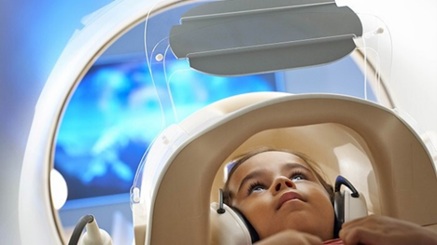
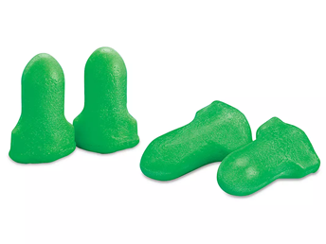
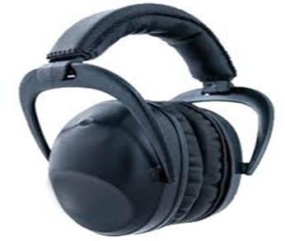
Hearing Protection
Current, available hearing protection options:
*Ear plugs
-one time use
-foam
-30 dB NRR
-one size
*Headphones
-adult sized
-rigid design, hard plastic or super soft foam

Slide 13
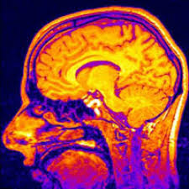
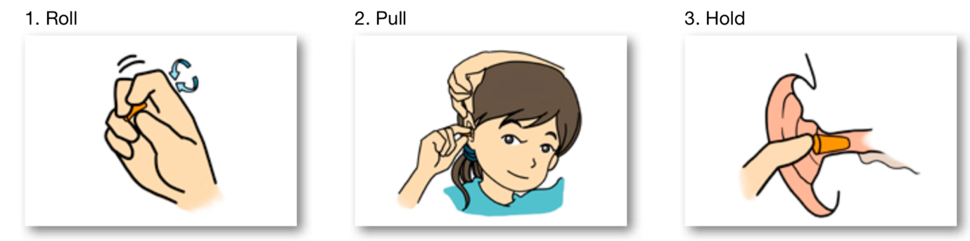
Proper Earplug Insertion
→Correctly inserted earplugs can reduce the level of sound exposure considerably, decreasing your risk of hearing damage (WHO)
→Correct Insertion of earplugs
1. Roll earplug between your thumb and forefinger to compress it.
2. Using your other hand, pull your ear up and back. This will increase the opening of the ear canal.
3. Insert the earplug into the ear canal, to a comfortable depth, and hold it in place with your finger until it expands in place securely.

Slide 14
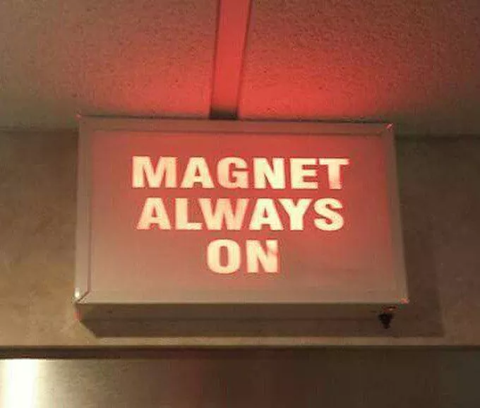
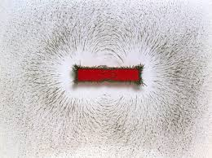
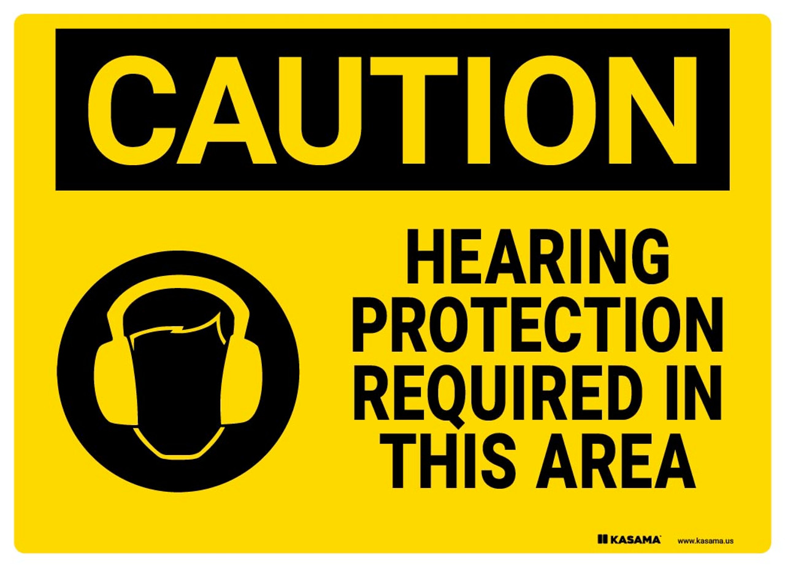
Just for Fun
→MRI machine noise from inside the room.
https://youtu.be/TIsrOtSSUQY?si=bdh7W0UxXBbX7JpZ
→MRI royalty free sound effects
https://www.pond5.com/search?kw=mri&media=sfx&dd_referrer=https%3A%2F%2Fwww.google.com%2F

Slide 15
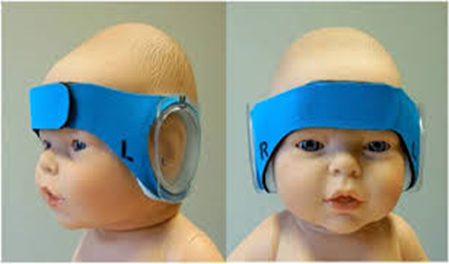
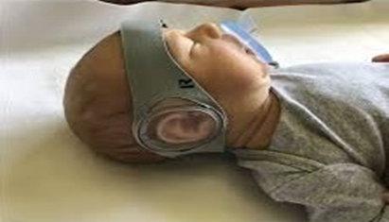
Quality Improvement Suggestion
+ Ideal for our littlest patients
-DREAMIES – hearing protection designed for neonates
through 2 years of age
– Comfortable – wraps around the head and
fastens securely – offers 27 dB of protection
-- Available in multiple sizes – remain in place
during imaging – can be used in conjunction
with ear plugs to increase protection

Slide 16
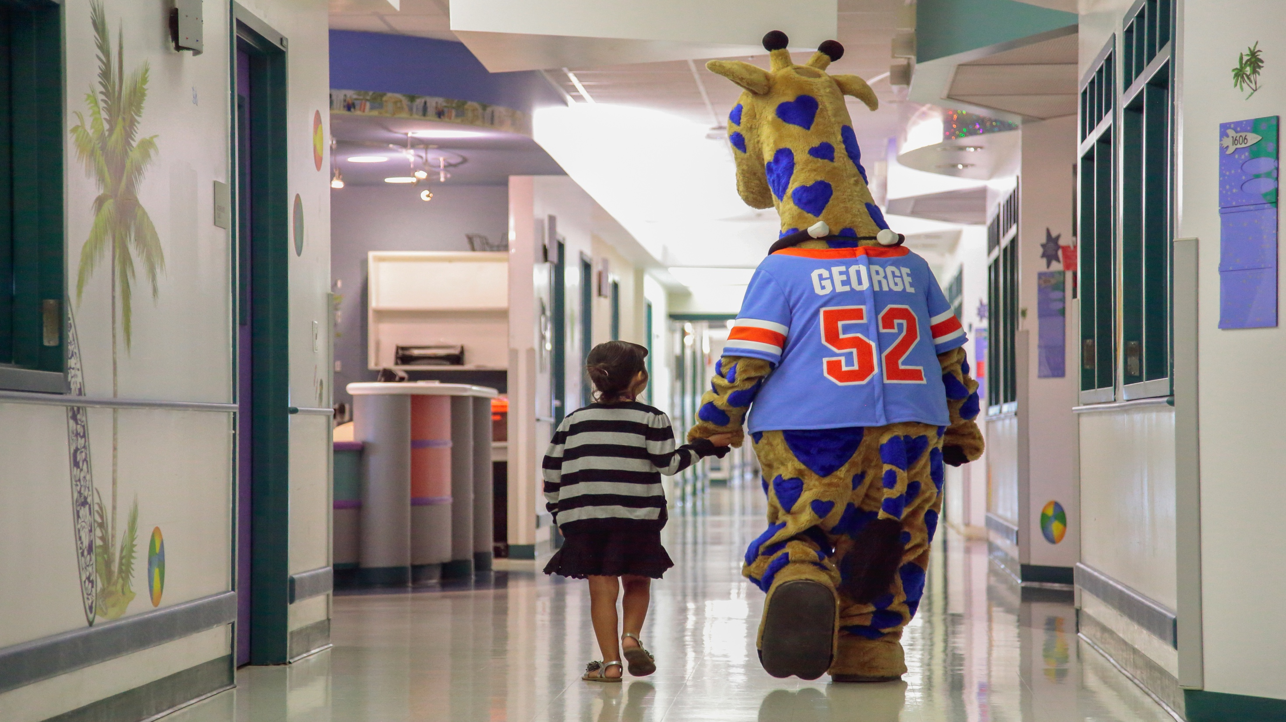
Conclusion
*MRI is a useful, effective diagnostic tool.
*The imaging team works diligently to ensure every patient receives the best, safest care possible.
*Acoustic noise from MRI machines can produce loud, repetitious sounds that can make our patients uncomfortable and can reach 138dB³.
*The most effective, available means of sound attenuation is hearing protection.
*Every patient is offered hearing protection every time.
*Currently available forms of hearing protection include coated, foam ear plugs that offer 30 dB of protection and headphones that offer an additional 7 dB of protection.
*Newer solutions in hearing protection are becoming more widely utilized.
*DREAMIES are a hearing protection solution designed for children from neonate through age two.
*Multiple sizes are available based on head size, and they are easy to apply.
*DREAMIES offer 27 dB of hearing protection for our most sensitive patients.
*DREAMIES would add an additional tool for technologists to use when providing hearing protection.
*Used in conjunction with existing hearing protection options, our kiddos here at Valley Children’s hospital would benefit from more than 50 decibels of protection while undergoing diagnostic imaging exams.

Slide 17
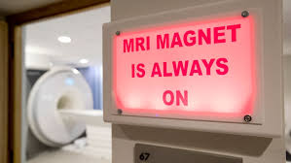
*Academic references can be obtained by e-mailing your request to Mkitzmiller@valleychildrens.org
*Many thanks and appreciation to the mentors and friends who helped along the way!
*Images obtained from free, widely available graphics archives on the internet.
*Thanks to MRIQuestions.com, MRISafety.com, MiniMuffs and DREAMIES
*Author has no financial disclosures or conflicts of interest.

