Slide 1

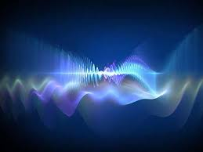

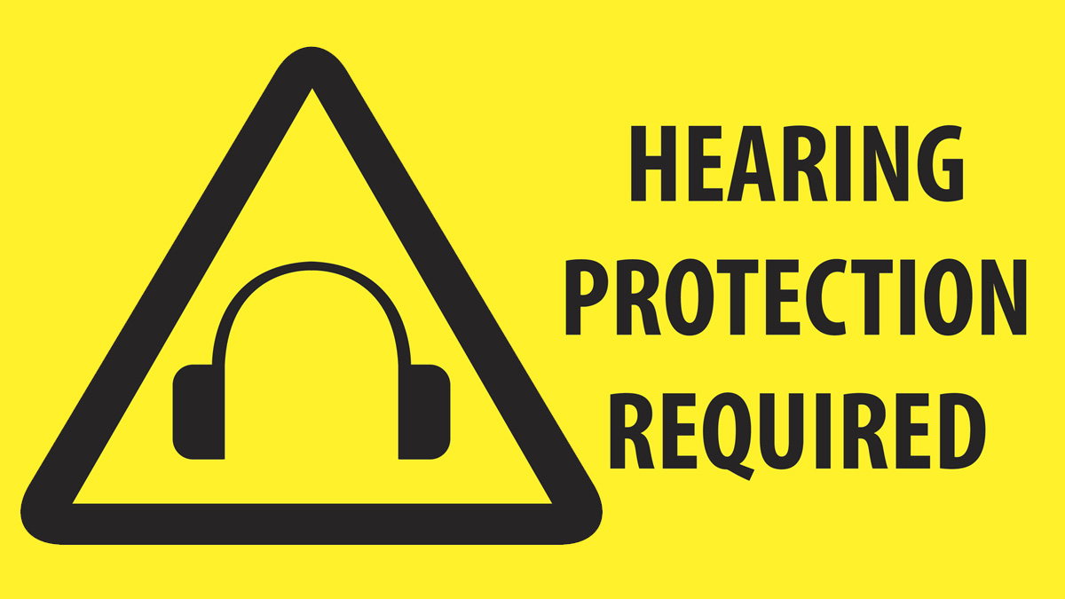
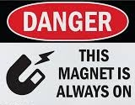
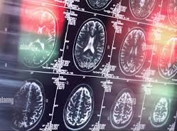
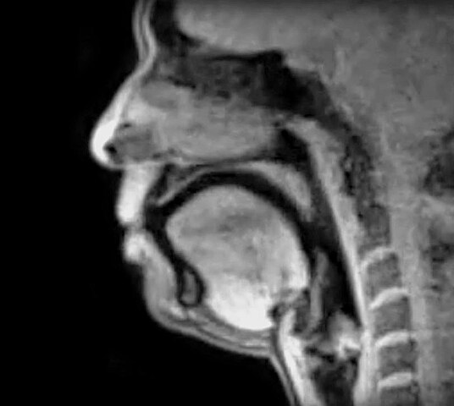
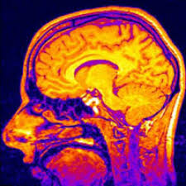
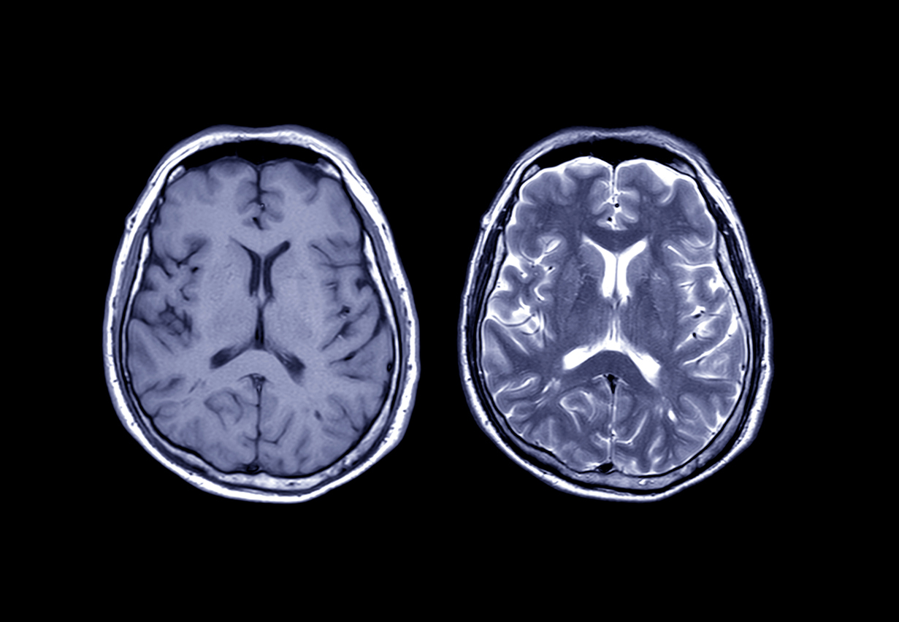
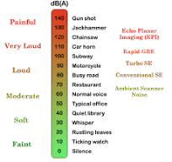
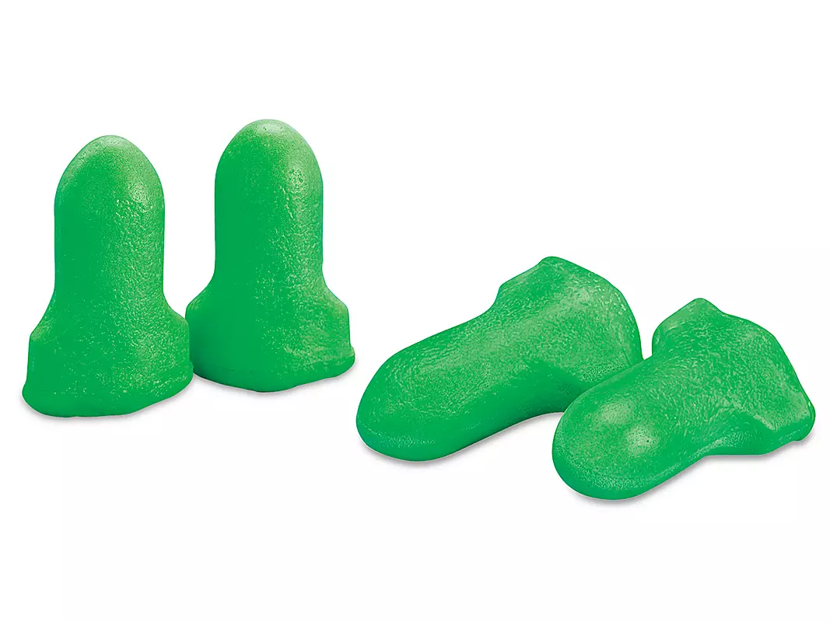
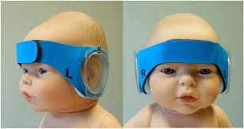
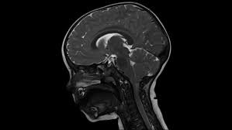
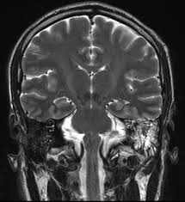
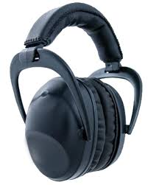
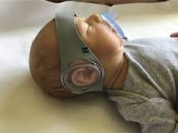
Sound Attenuation During MRI Exams
By: Melissa Kitzmiller, RT(R)(MR)(CT)(ARRT), BS, AS, AS, AA Mentors: Fred Laningham, MD; Bernette Orcutt, RT(R)(MR)(CT)(ARRT)
Introduction
Results
Conclusions
*MRI is one of the most powerful diagnostic imaging tools.
*MRI machines consist of a large cylindrical tunnel (bore)
and a non-ferromagnetic couch (patient table).
*The magnet is ALWAYS on.
*MRI exams expose patients to loud repetitious sounds –
often in excess of regulatory safe noise exposure levels.
*Sound Pressure Levels can climb as high as 138 dB³.
*Stronger magnets produce more sound – a 3T magnet
produces sounds that are louder than the sounds produced
by a 1.5 T magnet.
The Cause of Noise
+Loud tapping noises in MRI are caused by the rapid switching of gradients during MRI exams.
+Noise is also produced by the ”coldhead” in the cryostat as the re-condenser turns helium gas back into
liquid helium. This process helps keep the magnet cool.
Sound regulations
+FDA exposure limits for sound pressure levels = 140 dB and is based on occupational exposure limits
+OSHA recommends the use of hearing protection for noise exposure above 85 dB.
Risk
+ Exposure to loud noise can result in a reduction of the sensitivity of the hair cells in the organ of Corti and
a shift in the threshold of hearing.
Solutions
+Ear plugs – most are only adult size – offer 30dB of hearing protection
--Must be inserted correctly to provide level of protection
+Ear muffs or headphones – most are one size fits all – offer an additional 7dB of hearing protection
--can move and shift during imaging
+Protocol optimization – only available on our Siemen’s machine – Quiet Suite – built into the protocols
+Gradient coil shape – huge potential – starts at the machine design level – additional research is needed.
Quality improvement suggestion for an additional hearing protection option
+ Ideal for our littlest patients
-DREAMIES – hearing protection designed for neonates through 2 years of age
– comfortable – wraps around the head and fastens securely – offers 27 dB of protection
--Available in multiple sizes – remain in place during imaging – can be used in conjunction with ear
plugs to increase protection.
MRI is a useful, effective diagnostic tool.
The imaging team works diligently to ensure every patient receives the best, safest care possible.
Acoustic noise from MRI machines can produce loud, repetitious sounds that can make our patients uncomfortable and can reach 138dB³.
The most effective, available means of sound attenuation is hearing protection.
Every patient is offered hearing protection every time.
Currently available forms of hearing protection include coated, foam ear plugs that offer 30 dB of protection and headphones that offer an additional 7 dB of protection.
Newer solutions in hearing protection are becoming more widely utilized.
DREAMIES are a hearing protection solution designed for children from neonate through age two.
Multiple sizes are available based on head size, and they are easy to apply.
DREAMIES offer 27 dB of hearing protection for our most sensitive patients.
DREAMIES would add an additional tool for technologists to use when providing hearing protection.
Used in conjunction with existing hearing protection options, our kiddos here at Valley Children’s hospital would benefit from more than 50 decibels of protection while undergoing diagnostic imaging exams.
Objectives
Review current practices and methods of already implemented hearing protection through academic literature review.
Review current practices and methods of hearing protection at Valley Children’s Hospital.
Review MRI regulatory hearing protection standards as they apply to occupational safety as well as to the general public.
Create awareness for Best practice by identifying areas of potential improvement
Offer suggestions for additional hearing protection options for quality improvement
Design Methods
References
100 research studies were systematically reviewed.
At least 10 relevant, peer reviewed studies were selected.
Information regarding hearing, sound, hearing protection, shimming, gradient coil shape, protocol optimization and standard practice were collected.
Current hearing protection at Valley Children’s Hospital was assessed through observation, interviews, examination and research.
Alternative hearing protection was assessed for appropriateness, practicality, coverage, comfort, and ease of use.
*Academic references can be obtained by e-mailing your
request to Mkitzmiller@valleychildrens.org
*Images obtained from free, widely available graphics
archives on the internet.
*Thanks to MRIQuestions.com, MRISafety.com,
minimuffs and DREAMIES
*Author has no financial disclosures or conflicts of interest.

