Slide 1
MEDIATORS MATTERS
Unlearning & Relearning How We Select Mediators
Dr. Randy Lowry
Founder of the Straus Institute for Dispute Resolution
Pepperdine University Caruso School of Law
Malibu, CA

Slide 2
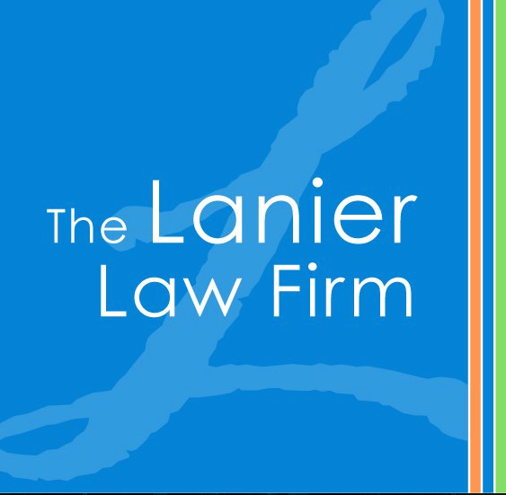
My Perspective
MANAGED THE MEDIATION PROCESS FROM EVERY SIDE!

Slide 3
New York, NY
San Diego, CA
Lexington, KY

Slide 4
“Mediation is no longer an experiment; it is how we do business.”
- Vice President of Claims for National Insurance Company

Slide 5
MEDIATION IS HOW WE DO BUSINESS
Settlement is the norm – trial is the alternative
90-95% of cases settle before trial
You are bringing experience and expertise

Slide 6
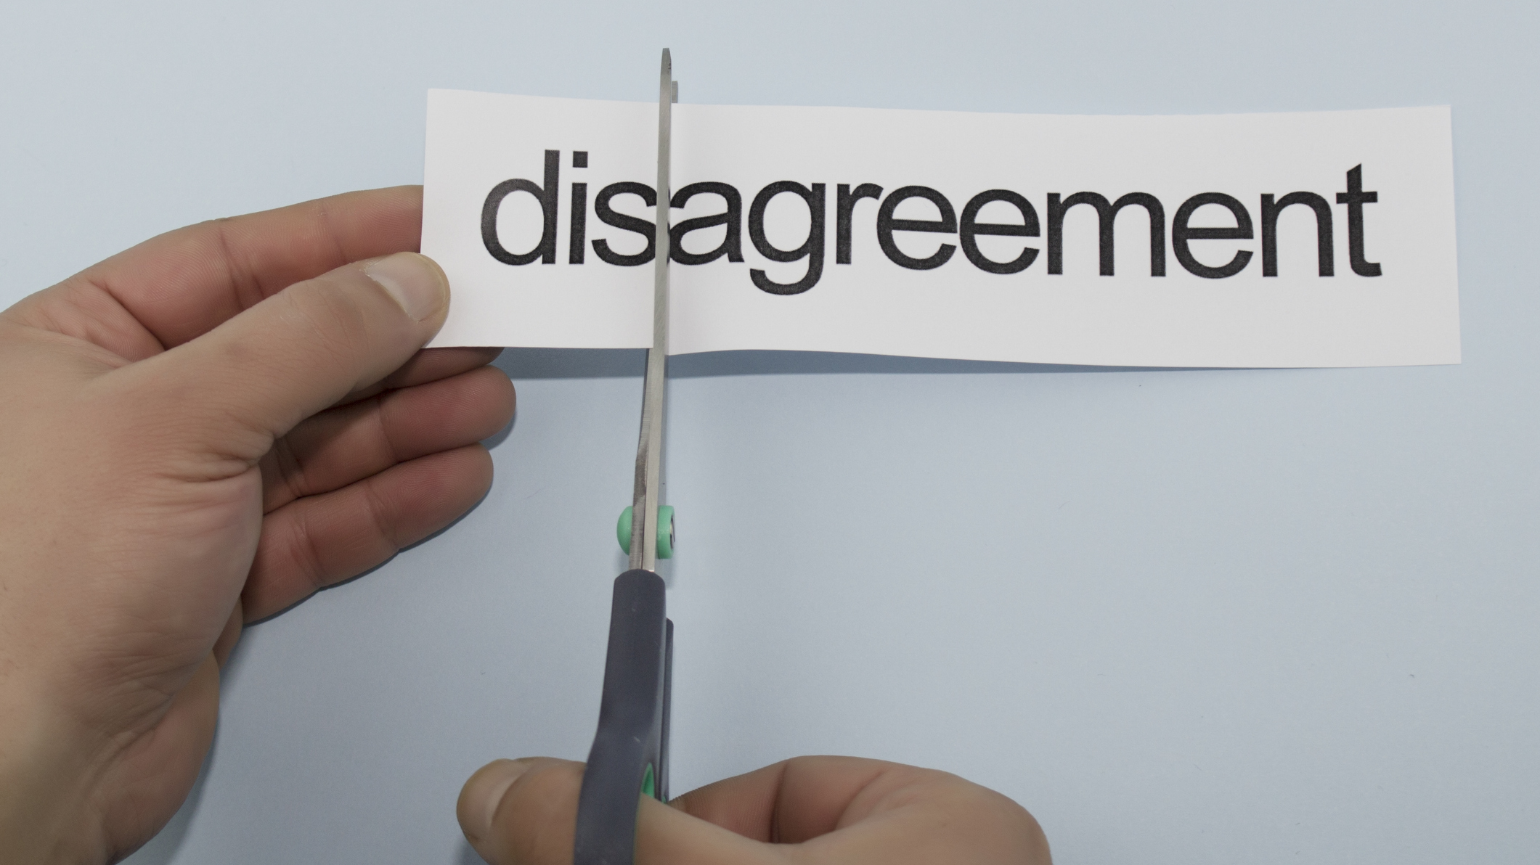
The Resolution Moment!

Slide 7
Mediation has a 80+% success rate
“Justice” happens at the table
Worthy of strategic investment

Slide 8
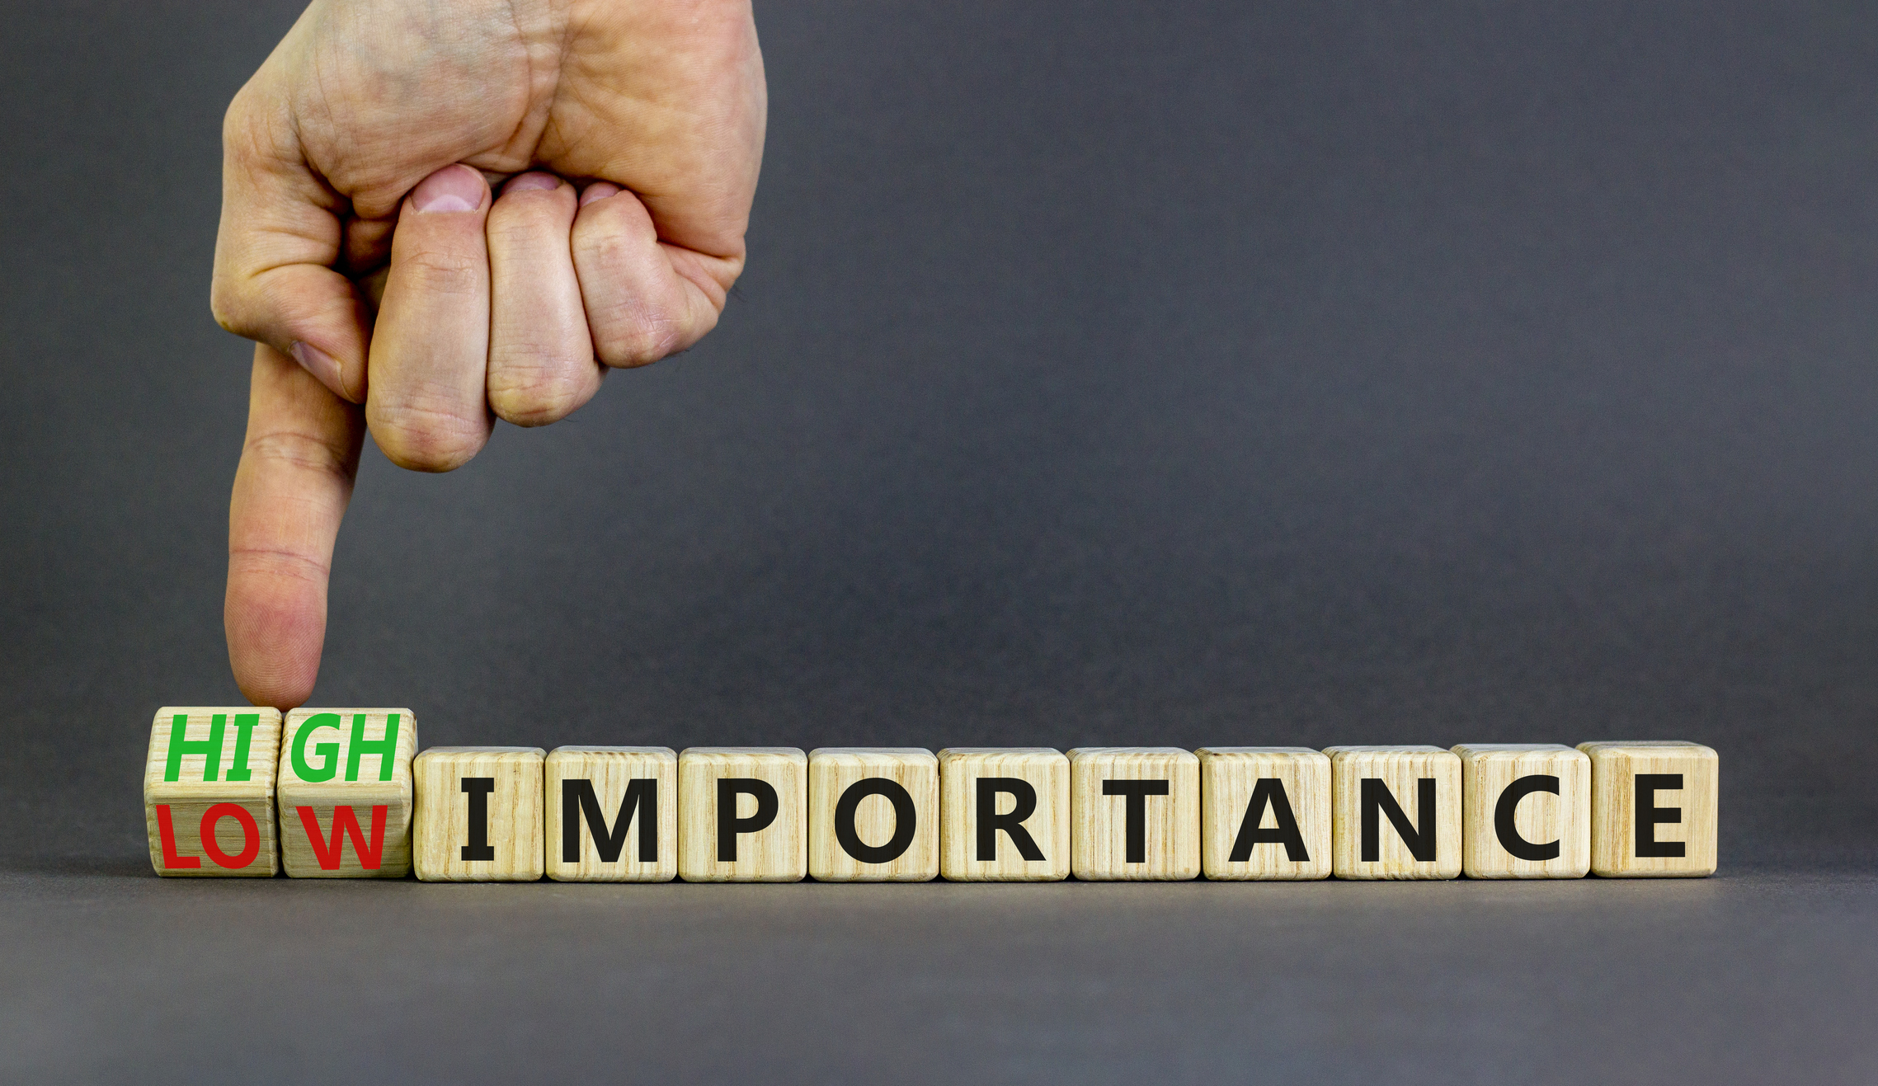
Selecting the mediator is a critical, strategic decision in catastrophic cases

Slide 9
Selecting a Mediator
1. DEFINE THE CASE ELEMENTS
2. IDENTIFY THE PEOPLE DYNAMICS
3. DETERMINE THE BARRIERS
4. MATCH SETTLEMENT NEEDS TO MEDIATOR CHARACTERISTICS

Slide 10
Mediator Characteristics
EVALUATIVE . . . . . . . . . . . . . . FACILITATIVE
Judgment of mediator Movement of the process
NARROW . . . . . . . . . . . . . . . . . BROAD
Issues to settle Conflict to resolve
SUBSTANCE . . . . . . . . . . . . . . PROCESS
What is the right answer? What is the right way to get
to the right answer?
ASSERTIVE . . . . . . . . . . . . . . . PASSIVE
The mediator’s process The parties’ process

Slide 11
Mediator Characteristics (Cont.)
LIMITED . . . . . . . . . . . . . . . . . . CONTINUING
Engaged for a time period Engaged until it’s done
DELIVER . . . . . . . . . . . . . . . . . . DRIVE
MESSAGES RESOLUTION
Shuttle with positions Structure a solution
STATIC . . . . . . . . . . . . . . . . . . DYNAMIC
Sticks to natural and preferred style Able to adapt style to case

Slide 12
DISCOVERING MEDIATOR CHARACTERISTICS
Review experience
Talk to colleagues
Interview mediator

Slide 13
Mediator Interview Questions
How would describe your mediation style and strategy?
How would those who have used you describe your work?
What experiences do you have that will help you understand the substance of this case?
How will you overcome barriers to settlement?
What is your strategy if we don’t reach a settlement at mediation?

Slide 14
Questions?

Slide 15
Three Takeaways
Prepare toward mediation as THE resolution moment in the case
Discover mediator characteristics
Select a mediator by matching settlement needs to characteristics

Slide 16
THANK
YOU!

