Slide 1
SEE YOU
AT TRIAL!
Signaling for Strategic Negotiation
Dr. John Lowry
Kevin Kuhn

Slide 3
The Right Answer ALL of the Time
IT DEPENDS

Slide 4
Six Stages of Settlement Advocacy
PREPARING
CONVENING
OPENING
POSITIONING
NEGOTIATING
CLOSING

Slide 5
STAGE ONE
PREPARING

Slide 6
PREPARING
Goal: Create as much as risk as possible for the Plaintiff
Strategy: Aggressively work up the case for mediation
Trial Counsel:
Early evaluation to assist in the possibility of an early resolution or begin working up an aggressive defense
Assist in selection and retention of strong, specialized experts
Begin working on defenses to problematic facts, witnesses, or opinions
Manage discovery well

Slide 7
STAGE TWO
CONVENING

Slide 8
Why Mediate?
AVOID RISK
AVOID COSTS
Nothing is 100%. Risk for both sides no matter how strong the case is
Simple: the longer the case, the more the costs incurred
SHOW EMPATHY
ACCESS TO PLAINTIFF
Allows the insured or hospital to be human
Allows the mediator to build a relationship and influence outcome
ALLOW CLOSURE
AVOID PUBLICITY
For the plaintiffs, but just as importantly, for the healthcare providers
Newspapers only like a plaintiff win. Never read: “Doctor Acquitted!”
TO LEARN
AVOID DISCOVERY
If it all fails, you have a minimum learned more about their arguments
Bad cases only get worse

Slide 9
CONVENING
Goal: Set up the mediation for the best chance of success
Strategy: Mediate at the right time, with the right resources, and the right mediator
Trial Counsel:
Negotiate selection of mediator
Strategically identify the right time to mediate
Address mediation issues (see next slide)
Set up in-person meeting with the mediator

Slide 10
Choosing a Mediator
KEY: IS THE MEDIATOR BOOKED MONTHS IN ADVANCE?
FACILITATOR
Asks questions, validates each side, avoids recommendations or advice, up to the parties to reach a fair resolution
EVALUATOR
Mediators are more likely to make recommendations, suggestions, and to express opinions
Instead of focusing primarily on the underlying interests of the parties involved, mediators may be more likely to help parties assess the legal merits of their arguments and make fairness determinations
MESSENGER
Simply a go between
FORMER JUDGE
By the afternoon, resorts to being a judge

Slide 11
CONVENING
Goal: Set up the mediation for the best chance of success
Strategy: Mediate at the right time, with the right resources, and the right mediator
Trial Counsel:
Negotiate selection of mediator
Strategically identify the right time to mediate
Address mediation issues
Set up in-person meeting with the mediator
Get ahead of plaintiff counsel’s anticipated tactics with mediator

Slide 12
Mediation Issues
KEY: GET IT OUT THERE IN THE OPEN!
Do I have what I need?
Interviewed staff? Medical records? Lien information? Bill v paid? Expert review?
Deal with Co-defendants
Pre-mediation mediation? Meeting with all defense counsel?
Terms up front
Confidentiality? Liens all covered? Dismissal of future actions?
Who attends?
Doctor? Hospital Representative? Broker? Second Look Counsel?

Slide 13
CONVENING
Goal: Set up the mediation for the best chance of success
Strategy: Mediate at the right time, with the right resources, and the right mediator
Trial Counsel:
Negotiate selection of mediator
Strategically identify the right time to mediate
Address mediation issues
Determine roles and responsibilities at mediation
Set up in-person meeting with the mediator

Slide 14
TRIAL COUNSEL PARTICIPATION AT MEDIATION
Four Approaches
Trial counsel does not attend mediation—sends the message that we are willing and ready to try the case
Trial counsel attends mediation to respond to arguments from plaintiff’s counsel and mediator with facts and evidence
Trial counsel attends mediation to provide a presentation/PowerPoint of defenses in joint session at mediation
Trial counsel attends mediation to lead the settlement negotiation with the mediator and plaintiff’s counsel

Slide 15
SETTLEMENT COUNSEL PARTICIPATION AT MEDIATION
Four Approaches
Settlement counsel provides advice and support only through the preparing and convening stages of the mediation
Settlement counsel does not attend mediation—works in real time via texts or phone calls with those present
Settlement counsel attends mediation in support of trial counsel or claims professional who is leading the negotiation with the mediator and plaintiff’s counsel
Settlement counsel attends mediation to lead the settlement negotiation with the mediator and plaintiff’s counsel

Slide 16
CONVENING
Goal: Set up the mediation for the best chance of success
Strategy: Mediate at the right time, with the right resources, and the right mediator
Trial Counsel:
Negotiate selection of mediator
Strategically identify the right time to mediate
Address mediation issues
Determine roles and responsibilities at mediation
Set up in-person meeting with the mediator

Slide 17
Plaintiff Tactics
Plaintiff attorneys will always test the defense
Outrageous demand prior to mediation
“Plaintiffs are not mediating unless the defense brings $1M [SIR amount, or some other amount].”
“I’m insulted by that offer!”
Simple “matching” offers
“I’m walking.”
No access to Plaintiff(s)

Slide 18
Defense Response
Decline Plaintiffs’ invitation to set the floor before mediation but tell them you are coming in good faith with real money
Have a plan prior to mediation (i.e., a predetermined settlement amount that the client, primary insurer, and excess insurer all agree on)
Ignore Plaintiffs’ histrionics and simply negotiate/make offers to reach your predetermined number

Slide 19
STAGE THREE
OPENING

Slide 20
OPENING
Goal: Manage expectations and start the dance
Strategy: Start aggressively as possible
Lead Negotiator:
Don’t be afraid to put the first number on the table
Be insulted by the outrageous opening offer from the plaintiff’s counsel
Know that one of your first three opening moves will create tension
Don’t be surprised or concerned that the mediator wants a bigger move from you at the start
Pick the number you believe is lowest amount required to successfully start the dance

Slide 21
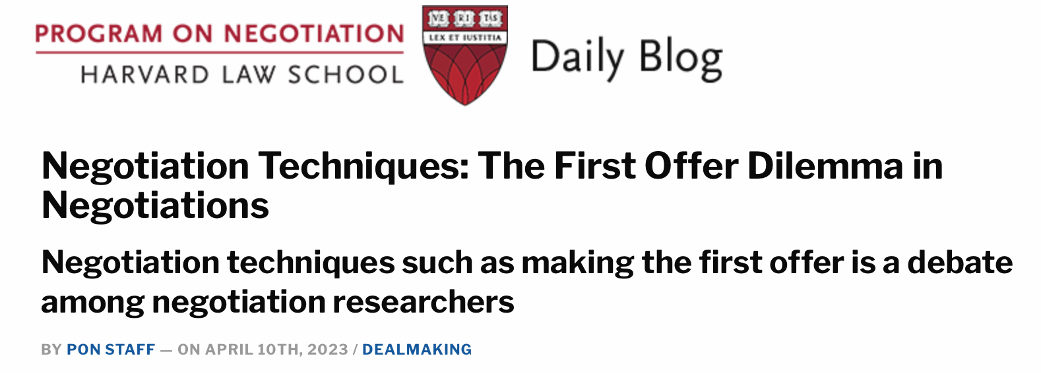
Opening

Slide 22
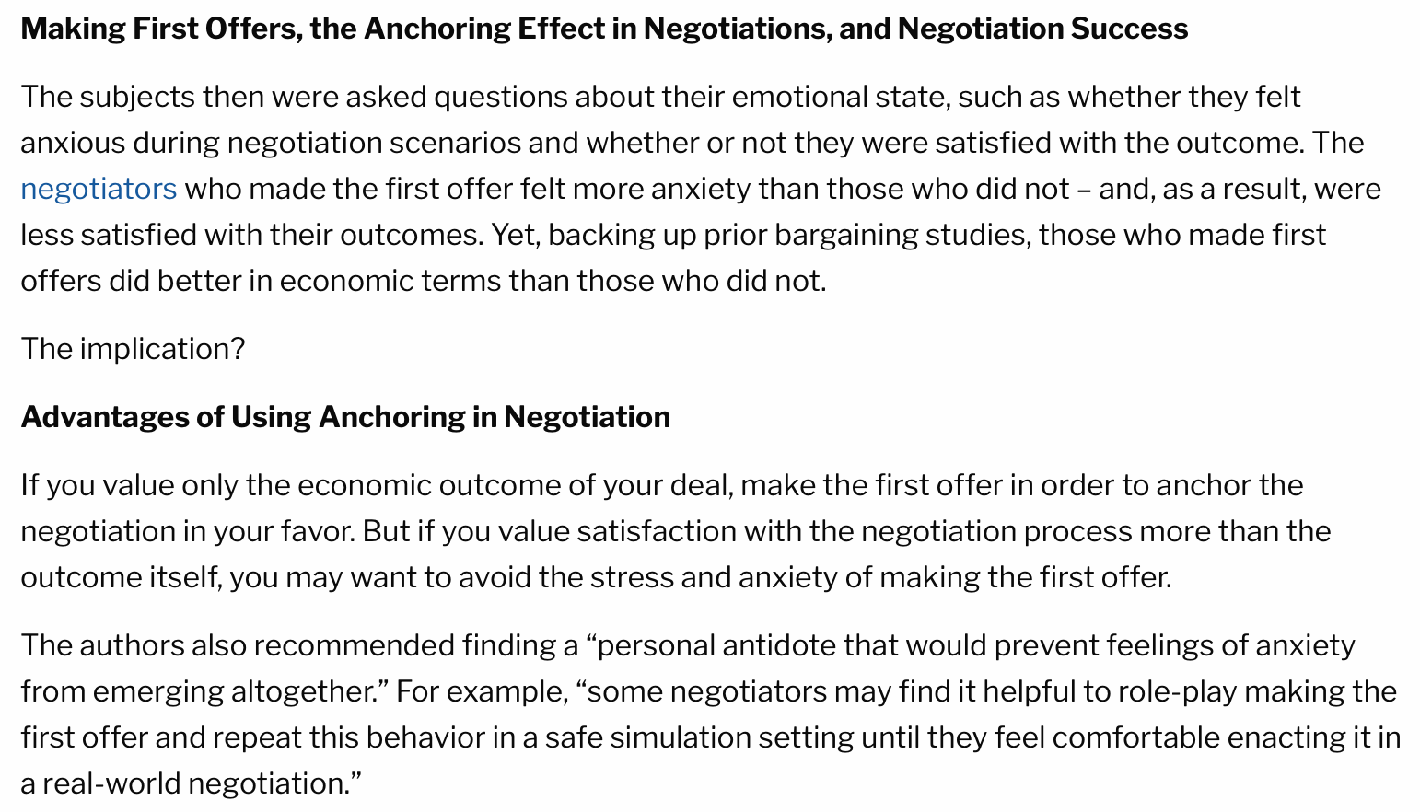
Opening

Slide 23
STAGE FOUR
POSITIONING

Slide 24
POSITIONING
Goal: Make the plaintiff believe you are not afraid to take the case to trial
Strategy: Present a strong defense even if it is difficult to work up
Trial Counsel:
Bring it!!!
Show no fear of taking the case to trial if necessary
Be extremely careful about any signal (even if unintended) that suggests a reluctance to take the case to trial or need to settle
Help plaintiff understand that a vast majority of med mal cases end in defense verdicts
Have your damages defense ready to go (hopefully with the help of Tom and Susan!)
Respond vigorously and confidently to everything thrown at you by the mediator (perception doesn’t always equal reality)

Slide 25
STAGE FIVE
NEGOTIATING

Slide 26
NEGOTIATING
Goal: Don’t overpay
Strategy: Lead with need and test numbers
Lead Negotiator:
Slow it down and stick to your plan – let the deal come to you (Don’t signal $6M until you have tested a settlement number of $5M.)
Demonstrate what your money will do for the plaintiffs
Acknowledge the negotiating phase may take multiple mediations and ongoing settlement negotiations over weeks or months
Resist the pressure to “put up enough money to make them sweat” until you know you are close to getting a deal
Be ready for the hypothetical negotiation - keep the midpoint moving in your direction
If the process isn’t leading to your desired outcome, shut it down

Slide 27
STAGE SIX
CLOSING

Slide 28
CLOSING
Goal: Get the deal and capture value
Strategy: Leverage the shift in risk
Lead Negotiator:
Don’t be too quick to settle, even though you know the case will settle
Give the other side a psychological victory by saying ”no” – make them believe they have captured every penny on the table
Hammer home the impact of the dollars on the table for the Plaintiff

Slide 29
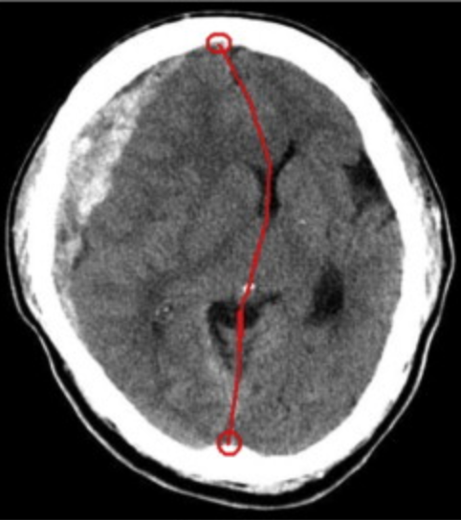
CASE
STUDIES

Slide 30
M. M., as Next Friend and Guardian of R.M. v. Hospital
________’s Further Confidential Mediation Statement for Mediator ________ ONLY
July 15, 2023
Kevin Kuhn
Shawn Neal

Slide 31
Location of M’s AVM: Lower Spine
T-11 to L-1

Slide 32
Timeline
April 3, 2015 (Friday) (Child’s DOB Jan. 16, 2015) | April 4, 2015 (Saturday)
1612 hrs – Arrives at ER (First ER Visit)
1625 hrs – Seen by Triage RN A______
1700 hrs – Seen by RN L_______
1710 hrs – Seen by PA A_______
1941 hrs – Seen by Dr. R_______
Seen by Lactation RN
2055 hrs – Discharged (nearly 5 hours later)
~0100-0200 – Sudden, Significant change in condition at home – legs go limp, feet hot, oddly quiet
0203 hrs – Arrives at ER (Second ER Visit)
0529 hrs – Transferred to Hospital
0618 hrs – Arrives at Hospital
0700-1717 hrs – Evaluated at Hospital
1718 hrs – Spine surgery begins at Hospital

Slide 33
Sudden, Significant Dramatic Change
First ER Visit | Home (0100-0200 hrs)
No seizure-like activity No neurological abnormalities No leg weakness or paralysis | Limp legs Legs really warm Feet hot Oddly quiet
Notes:
Double check if Mom said “red hot” or just “hot”

Slide 34
Plaintiffs Required to Prove
Negligence – That ER providers and hospital failed to use reasonable care
Causation – That the alleged negligence caused the child’s injuries
Never Reach the issue of damages unless both Negligence and Causation proved by Plaintiffs by the greater weight of the evidence
+

Slide 35
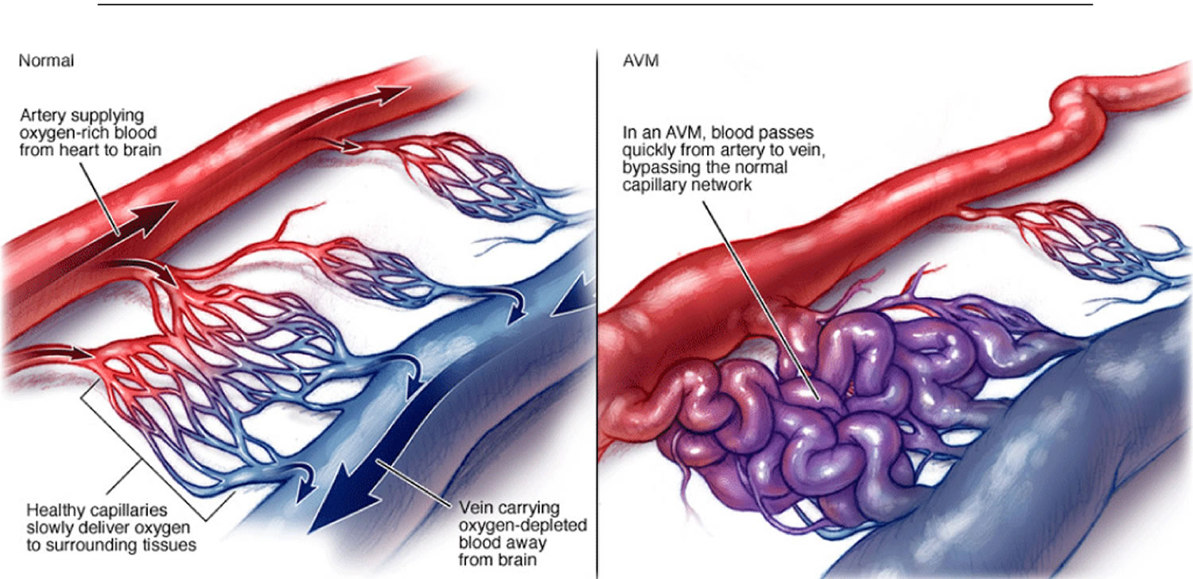
Extraordinarily Rare Birth Defect
Incidence: One in a Million
Normal
AVM
35

Slide 36
M_______’s Birth Defect—Caused by No One
ArterioVenous Malformation (“AVM”)—on her spinal cord
“[C]omplex neurosurgical lesions that are very challenging to manage”
Why? Because it goes undiagnosed until patient begins to experience signs and symptoms
First signs and symptoms here were child’s “limp legs”
Arteries and veins in a spinal AVM can spontaneously rupture and cause hemorrhage, bleeding in the spinal cord through no fault of anyone
[
Notes:
AVMs don’t typically bleed in a 2.5 month old
Both neurosurgeons have never seen it, despite over 60 years of combined experience [~35 yrs for Steinberg (defense expert) & ~25 yrs for Taylor (Plaintiffs’ expert)]

Slide 37
Unforeseeable and Exceedingly Rare
Spinal AVM in 2 ½ month old baby
Weight: 5.03 kilograms – 11.08 lbs.
Height: 57 cm – 22.4 inches in length
Never symptomatic until “limp legs” at home, after first ER visit, around 0100 to 0200 hours
Notes:
Military times

Slide 38
Hospital’s Reasonable Workup: 5+ Hours to Perform MRI; 11+ Hours to Perform Surgery
April 4 (Saturday)
0823 Baby Gram X-ray Ordered
0824 X-Rays Lower Extremities Ordered
0834 MRI Brain Ordered
0834 MRI Spine Ordered
0845-0900 Labs Drawn
Arrives at Hospital
Second ER Visit
0203
0907 Versed Ordered
Leaves Hospital by
Ambulance
0529
Arrives
at
Hospital #2
0618
Nursing Assessments
0700; 0755
Neurologist Consult
1505
Neuro-surgeon Consult
~1530
Spine Neurosurgery
Begins
1718
0927 Leg X-Rays
0927 Babygram Views of the Legs
1113-1242 Imaging (Child medically sedated for MRIs)
0200
hrs.
0300
0400
0500
0600
0700
0800
0900
1000
1100
1200
1300
1400
1500
1600
1700
11 Hours, 49 Minutes
(Transfer from Hospital Until Surgery)
Limp Legs; Sudden Onset
38
Notes:
Get specific feedback from jurors on demonstratives like that

Slide 39
Plaintiffs’ Argument #2: If Imaging Ordered at Hospital?
Option A
Option B
May have ordered brain imaging – normal; and done nothing different
May have ordered brain imaging, seen hemosiderin; and done nothing different
Same Outcome
39

Slide 40
The Evidence Answers 8 Questions
Did the child have seizures in first ER visit?
Did the child have any abnormal neurologic findings in the first visit?
Was the child consolable in the first ER visit?
Did the child have any problems with her legs in the first ER visit?
During the first ER visit did 5 different healthcare providers see the child?
Did the parents say anything about seizures to these healthcare providers during the first visit?
Any reason to sedate child and stick needle in her lower back?
Are there consequences to CT and MRI scans?
NO
NO
YES
NO
YES
NO
NO
YES

Slide 41
Cord Prolapse Case

Slide 42
A Poor Medical Result — No Evidence of Wrongdoing by Healthcare Providers
Cord Prolapse rare and uncommon
Happens with normal rupture of membranes
Happens with normal vaginal deliveries
Happens to pregnant women at home
Does not mean anyone did anything wrong
“[T]he reality of medical practice is sometimes things are done perfectly correctly and yet something tragic happens.”
H. Miller Depo. 125:6-8

Slide 43
Reasonable for Mother to Choose Labor Induction and AROM
39 weeks (term)
2 prior vaginal deliveries (no complications), including prior induction and AROM
Mother young and healthy – 26 years old
Closely followed by CNM K during pregnancy care (after mother switched care)
Mother wanted induction and AROM
11

Slide 44
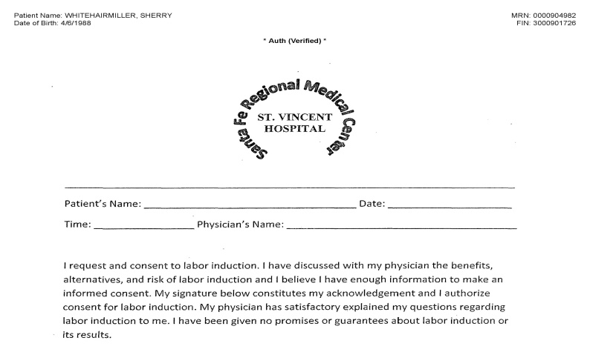
Mother’s Signed Consent to Induction of Labor
Mother signed at noon on 10/17/14
I request and consent to labor induction. I have discussed with my physician the benefits, alternatives, and risk of labor induction and I believe I have enough information to make an informed consent. My signature below constitutes my acknowledgement and I authorize consent for labor induction. My physician has satisfactory explained my questions regarding labor induction to me. I have been given no promises or guarantees about labor induction or its results.

Slide 45
Jury Instruction: Liability must be determined before damages
“You are not to engage in any discussion of damages unless you have first determined that there is liability, as elsewhere covered in these instructions. The fact that you are given instructions on damages is not to be taken as an indication as to whether the court thinks damages should or should not be awarded.”
No Damages if No Liability
No Sympathy
No Speculation
Fair & Reasonable Compensation

Slide 46
M’s Abilities According to Dr. S (Plaintiffs’ Expert)
Now:
Ambulates with assistance
Doing well in school
“Very smart little girl”
Meeting other developmental milestones
Future:
Live independently
Attend college
Work
Drive with hand controls
Form meaningful friendships and romantic relationships
Have children

Slide 47
Should not reach damages, but if you do… Fair and Reasonable Damages
REASONABLE DAMAGES
ECONOMIC
Past Medical Expenses | $ 134,613.05
Future Medical & Help at Home | $ 2,624,954.48 [based on past medicals] - $2,937,197.00 [based on reasonable LCP]
Lost Earnings (30 years) | $ 1,500,000.00
NON-ECONOMIC:
Pain & Suffering |  | $ 250,000.00
Lost Enjoyment |  | $ 250,000.00
TOTAL DAMAGES |  | $ 4,759,567.53 – $ 5,071,810.05

Slide 48
Verdict in Favor of Defendants
 | Claim | Verdict
1 | Was Defendant Hospital negligent? | NO
2 | Was Defendant Corporate Health negligent? | NO
3 | Was the negligence, if any, of Defendant Hospital a cause of Plaintiffs’ injuries and damages? | NO
4 | Was the negligence, if any, of Corporate Health a cause of Plaintiffs’ injuries and damages? | NO
5 | Were D.R., M.D., and C. A., PA, apparent agents of Defendant Hospital? | NO
6 | Total amount of damages suffered by Plaintiffs: | $0

Slide 49
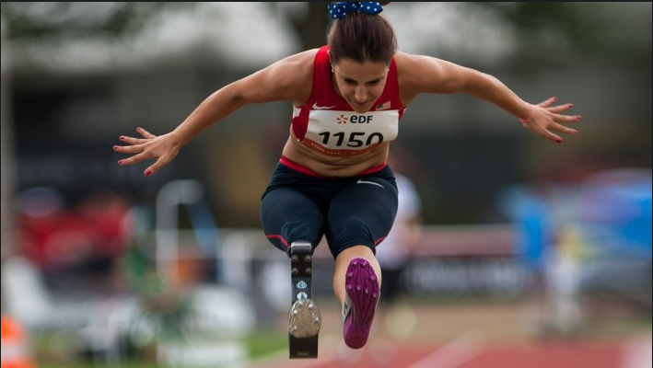
Lacey Henderson

Slide 50
Questions?

Slide 51
Three Takeaways
Signal you are ready and willing to try the case
Be proactive, not reactive at each stage of the mediation/settlement negotiation
Strategy over comfort

Slide 52
THANK
YOU!

