Slide 1
Damages: Is Your Life Care Plan the Key to Paying Less?
Thomas Geroulo, Esq
Susan L Combs, PPACA, ChHC, REBC

Slide 2
Conventional Wisdom
Tradition has been that the plaintiff develops the damages, and defense is not involved in those early stages of damages development.
Typically, defense is focused on challenging liability through standard of care or causation.
Question: What are the perspectives from all sides on damages at the outset of the case?

Slide 3
Discovery, Data and Defend Damages
These big cases are not one offs.
You need to be developing damages discovery early.
Ask about liens
Ask about coverage
Ask about future plans
Ask about costs
You need to harvest data, reflect on data and use data going forward to make sense of the claims.

Slide 4
The Collateral Source Rule
What is the common law collateral source rule?
Prohibits a defendant from reducing damages the plaintiff receives in a tort action by third-party payments received by the plaintiff
13 states and the District of Columbia adhere to the common law rule
Other states have modified the rule to varying degrees (PA has a modified version)
To date, this rule has been the biggest source of debate between litigants to price medical expenses

Slide 5
Navigating The Collateral Source Rule
Growing number of courts are accepting the argument that reasonable value is what is generally paid in the marketplace
What is the range of reasonable value? What do providers accept for payment?
Is it reasonable/permissible to argue that not necessarily what was billed is correct?

Slide 6
Settlement Valuation Topics
Will you discuss Medicaid? Medicare? Private insurance?
What type of evidence can be presented?
Is there evidence that makes sense to both sides?
Is it fair to say there is one discussion for mediation and another for trial?

Slide 7
Why it’s important to have your own team.
Life Care Planners
Economists
Health Insurance Experts
Structured Settlement Perspectives

Slide 8
This Photo by Unknown Author is licensed under CC BY-NC-ND

Slide 9
Susan Work Product Examples

Slide 10
Plaintiff Life Care Plan Valued at: $5.9-$10.8mil
Option 1: No Home Care |  |  |  | Option 2: Home Care
Insurance Costs to Life Expectancy of Through Age 74 |  |  |  | Insurance Costs to Life Expectancy of Through Age 74
 | Annualized Insurance Premium | $458,173.68 |  |  | Annualized Insurance Premium | $458,173.68
 | Annualized Maximum Out of Pocket | $504,000.00 |  |  | Annualized Maximum Out of Pocket | $504,000.00
 | Total Insurance Related Costs: | $962,173.68 |  |  | Total Insurance Related Costs: | $962,173.68
Non-Recurring Costs Not Covered by Insurance |  |  |  | Non-Recurring Costs Not Covered by Insurance
 | Medical Care | $0.00 |  |  | Medical Care | $0.00
 | Therapy | $0.00 |  |  | Therapy | $0.00
 | Medications | $0.00 |  |  | Medications | $0.00
 | Home Care | $0.00 |  |  | Home Care | $0.00
 | Total Non-Recurring Costs | $0.00 |  |  | Total Non-Recurring Costs | $0.00
Recurring Costs Not Covered by Insurance |  |  |  | Recurring Costs Not Covered by Insurance
 | Medical Care | $0.00 |  |  | Medical Care | $0.00
 | Therapy | $0.00 |  |  | Therapy | $0.00
 | Medications | $6,180.96 |  |  | Medications | $6,180.96
 | Home Care | $0.00 |  |  | Home Care | $4,951,320.08
 | Total Recurring Costs: | $6,180.96 |  |  | Total Recurring Costs: | $4,957,501.04
Grand Total: |  | $968,354.64 |  | Grand Total: |  | $5,919,674.72

Slide 11
Section Example: Medication
Recommendation |  |  |  | Life Care Plan OOP Annual Estimations Not Covered by Insurance
Item/Service | Frequency | Comment | Patient Responsibility*&** | Recurring: Ages 3-49 | Recurring: Ages 50-59 | Recurring: Ages 60-LE | Non-Recurring
Tacrolimus | Monthly Needs ages 12-LE | Covered by Insurance, Tier 1 | No Charge after the $7000 deductible has been reached as the deductible & Maximum Out of Pocket are equal. | $0.00 | $0.00 | $0.00 | $0.00
Mycophenolate | Monthly Needs ages 12-LE | Covered by Insurance, Tier 1 | No Charge after the $7000 deductible has been reached as the deductible & Maximum Out of Pocket are equal. | $0.00 | $0.00 | $0.00 | $0.00
Qbrelis 1mg (Lisinopril) | Monthly Needs for 8 years during LE | Covered by Insurance, Tier 1 | No Charge after the $7000 deductible has been reached as the deductible & Maximum Out of Pocket are equal. | $0.00 | $0.00 | $0.00 | $0.00
Lisinopril 10mg | Monthly Needs ages 10-LE | Covered by Insurance, Tier 1 | No Charge after the $7000 deductible has been reached as the deductible & Maximum Out of Pocket are equal. | $0.00 | $0.00 | $0.00 | $0.00
Sildenafil 10mg | Monthly Needs for 8 years during LE | Covered by Insurance, Tier 1 | No Charge after the $7000 deductible has been reached as the deductible & Maximum Out of Pocket are equal. | $0.00 | $0.00 | $0.00 | $0.00
Sildenafil | Monthly Needs ages 10-LE | Covered by Insurance, Tier 1 | No Charge after the $7000 deductible has been reached as the deductible & Maximum Out of Pocket are equal. | $0.00 | $0.00 | $0.00 | $0.00
ASA 81mg (Aspirin) | Monthly Needs to LE | Covered by Insurance, Tier ACA ages 50-59; other years $60/yr | Ages 50-59, No Charge. All other ages, patient pays 100% of charges. | $60.00 | $0.00 | $60.00 | $0.00
Vitamin D3 | Monthly Needs to LE | Not Covered by Insurance, OTC. Per LCP Estimations: $16.49/yr | 100% | $16.49 | $16.49 | $16.49 | $0.00
MVI (Multivitamin) | Monthly Needs to LE | Not Covered by Insurance, OTC. Per LCP Estimations: $17.69/yr | 100% | $17.69 | $17.69 | $17.69 | $0.00
HCTZ 10mg (Hydrochlorothiazide) | Monthly Needs to LE | Covered by Insurance, Tier 1 | No Charge after the $7000 deductible has been reached as the deductible & Maximum Out of Pocket are equal. | $0.00 | $0.00 | $0.00 | $0.00
Spironolactone 25mg | Monthly Needs to LE | Covered by Insurance, Tier 1 | No Charge after the $7000 deductible has been reached as the deductible & Maximum Out of Pocket are equal. | $0.00 | $0.00 | $0.00 | $0.00
Lasix 10mg (Furosemide) | Monthly Needs to LE | Covered by Insurance, Tier 1 | No Charge after the $7000 deductible has been reached as the deductible & Maximum Out of Pocket are equal. | $0.00 | $0.00 | $0.00 | $0.00
Total Annual Cost Not Covered by Insurance |  |  |  | $94.18 | $34.18 | $94.18 | $0.00
Evaluation is subject to change based on further information provided by physicians, life care planners, economists or other experts.
*Maximum Out of Pocket for patient annually, In Network is $7000, then 100% is covered by insurance for all covered services and medications in accordance with stated plan limits.
** Most specialty drugs require prior authorization for medical necessity. If covered, specialty drugs cannot be obtained from a network retail pharmacy and must be obtained from a Blue Shield Network Specialty Pharmacy.

Slide 12
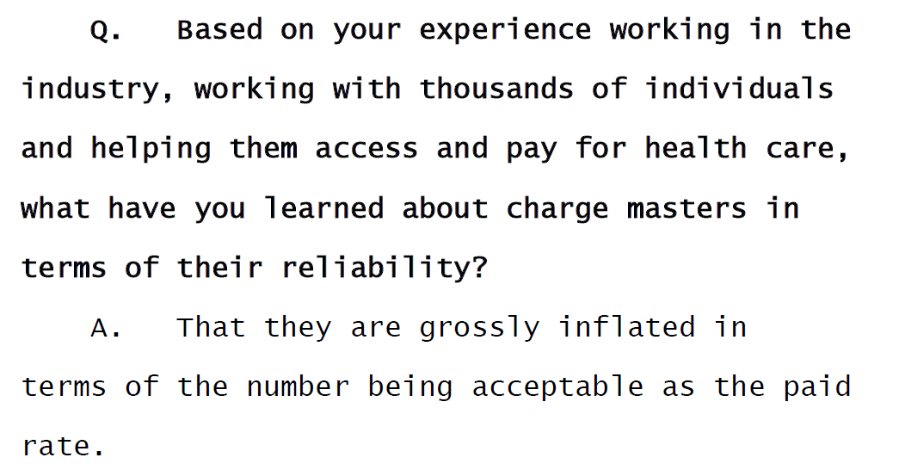
Susan in Court in Chicago!
This Photo by Unknown Author is licensed under CC BY-NC

Slide 13
Get Creative
Case Management or Fiduciary = Plaintiff will have Insurance
Public Law 101-476 (Equal Education Opportunities)
Is a facility really needed?
Use your experts to help prep you!

Slide 14
Tom Work Product Examples

Slide 15
Tom’s Example of a Real Case Product
Matching Susan to a serious birth injury case
Incorporating Medicaid
Incorporating Structured Settlement considerations
Successfully used in a mediation

Slide 16
Database Example

Slide 17
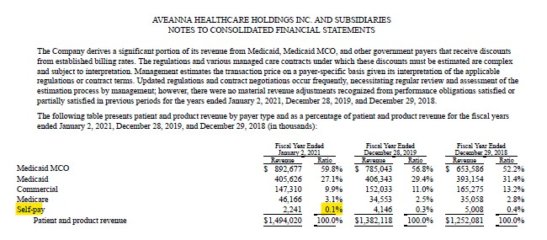
Investment Data
Securities and Exchange Commission S-1 Filing

Slide 18
Data We Built—Doing an LCP’s Homework

Slide 19
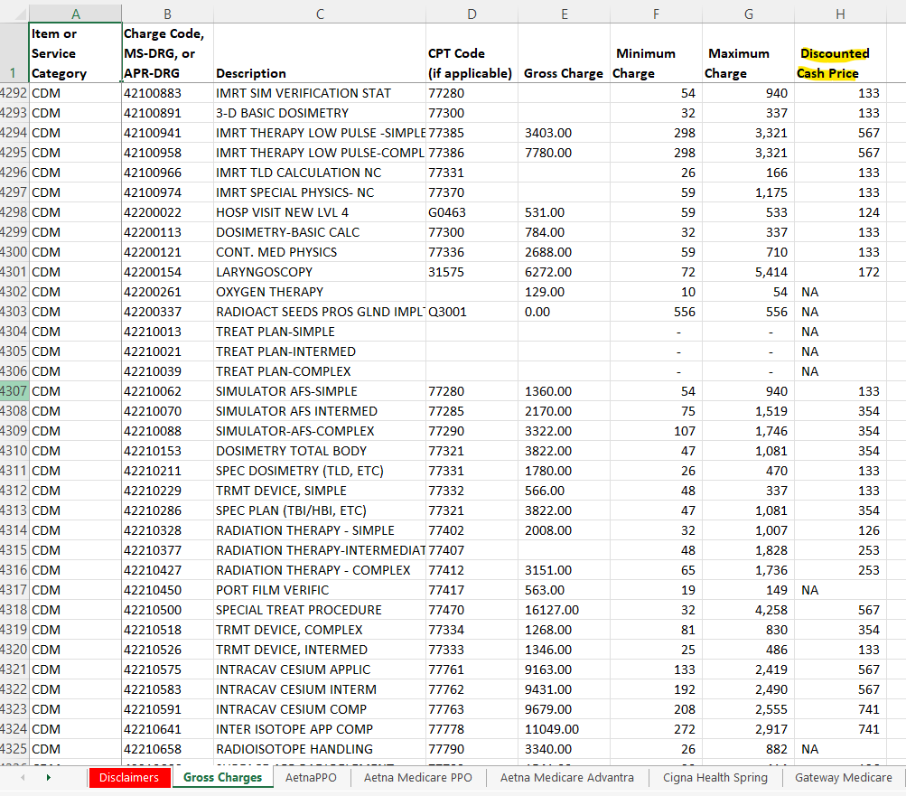
Charge Rate vs. Paid Rate

Slide 20
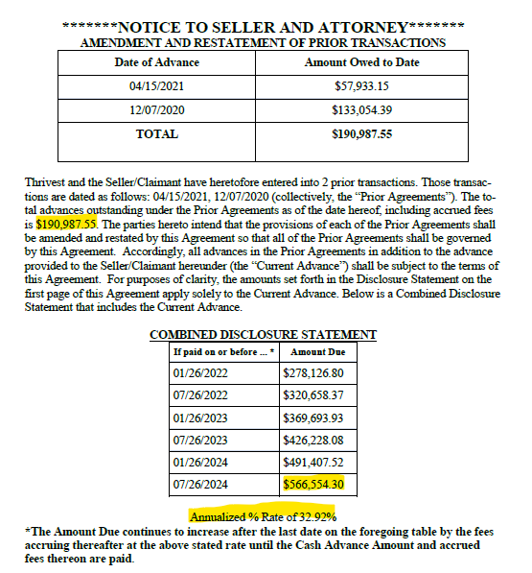
Share Amongst Yourselves

Slide 21
Probate Law and Damages Mitigation
Spend more time on the role of Guardians/Conservators
Discovery
Depositions of Guardians as Guardians
Depositions of Banks when they are Guardians
Litigating Issues Such as Trusts and MSA’s

Slide 23
Damages: Is Your Life Care Plan the Key to Paying Less?
Thomas Geroulo, Esq
Susan L Combs, PPACA, ChHC, REBC

