Slide 1
AEIX Claims Caucus Workshop Numbers Don't Lie: Dramatic Increases in Medical Liability Settlements and Verdicts
Jean-Paul A Rebillard, President, MedPro Specialty
April 26 2022 · Houston TX

Slide 2
Loss Severity – topics for consideration
Introduction
Loss data
Verdicts
Social inflation
Economic inflation
COVID-19 impact
Tort reform
Industry results
HCLMarketUpdate.com
Call to action

Slide 3
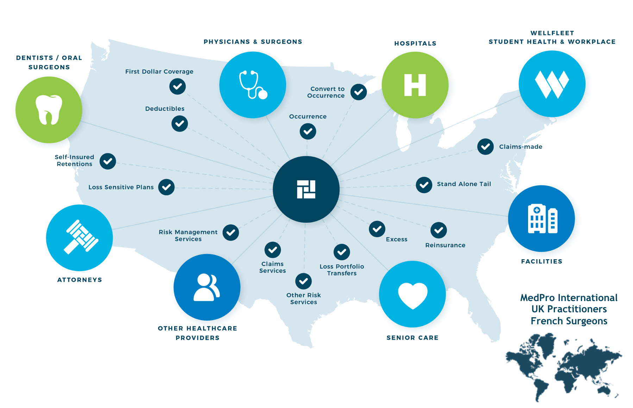
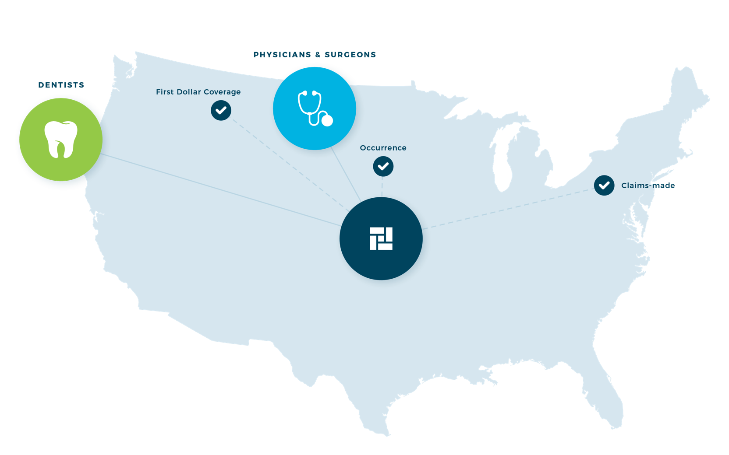
MedPro evolution: 2005 (only US & “first dollar docs”) to today
Since 1899 – more than 2x the length of our nearest US competitors – MedPro has been providing industry-leading healthcare liability insurance solutions to healthcare providers … today we do all that and much more
2005
Today
MEDPRO INTERNATIONAL

Slide 4
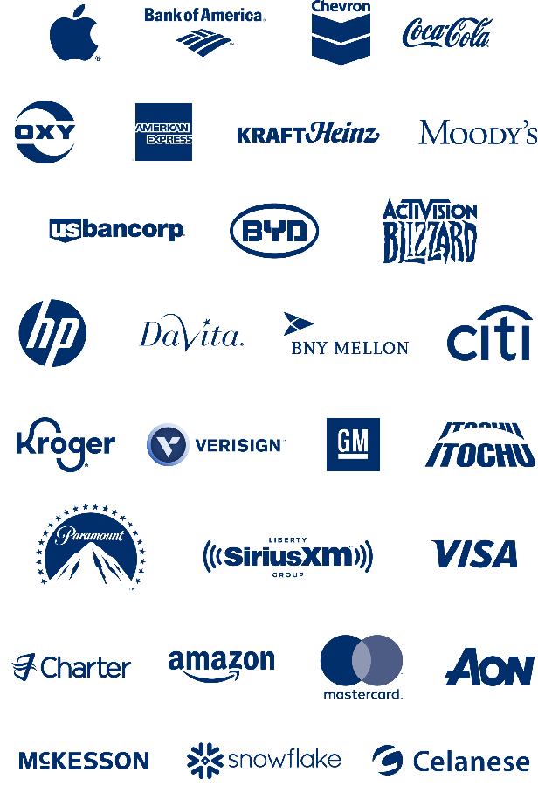
Berkshire Hathaway provides unrivaled stability
MedPro is one of 60+ business units within Berkshire ...
... and Warren asks us all to “run the business as if it’s your family’s only asset for 100 years”
~50 NON-INSURANCE SUBS
12 INSURANCE SUBS
UW Income and Float from insurance operations drives BRK growth
INVESTMENTS > $1B
Acme Brick
AHP
Ben Bridge
Benjamin Moore
BH Automotive
BH Energy
BNSF
Borsheims
Brooks
Business Wire
Charter Brokerage
Clayton Homes
CORT
CTB
Dairy Queen
Detlev Louis
Duracell
Fechheimer
FlightSafety
Forest River
Fruit of the Loom
Garan
H.H. Brown Shoe
Helzberg Diamonds
HomeServices
IMC Int'l Metalworking
Johns Manville
Jordan's Furniture
Larson-Juhl
LiquidPower Specialty
Lubrizol
Marmon
McLane
MiTek
Nebraska Furniture Mart
NetJets
Oriental Trading
Pampered Chef
Precision Castparts
R.C. Wiley
Richline Group
Scott Fetzer Companies
See's Candies
Shaw Industries
Star Furniture
TTI
WPLG
XTRA
Alleghany
BH Guard
BH Homestate Companies
BH Reinsurance Group
BH Specialty Insurance
Central States Indemnity
GEICO
GenRe
MedPro
MLMIC
National Indemnity Primary
United States Liability
Investments as of 09/01/2022

Slide 5
Frequency & Severity trends
Frequency trending flat from 2016 & Severity trending up from 2017 … until COVID-19 disruption
What will happen when claims are made for "post-COVID-19 catchup care" & court backlogs are resolved?
Source: National Practitioner Data Bank Public Use Data File, December 2022, Physicians & Surgeons Countrywide

Slide 6
Paid loss growth accelerating
Trend increasing steadily 2010-17 and spiking 2017-19 (data noisy since 2020)
Losses trended lower than inflation from 1996 to 2019 (0.6% loss vs. 2.2% CPI) … how will losses be impacted by 5.1% inflation trend from 2019 to 2022?
Source: S&P Global Market Intelligence

Slide 7
Industry losses shifting from HC Providers to HC Entities
Source: S&P Global Market Intelligence

Slide 8
$10M+ verdicts increasing in frequency
… returning to pre-pandemic trajectory as courts reopen countrywide
Source: Trans Re and various internet articles with publication dates between 1/1/2016 and 4/12/2023

Slide 9
$25M+ aberration verdicts increasing
Source: Trans Re and various internet articles with publication dates between 1/1/2016 and 4/12/2023

Slide 10
$10M+ verdicts increasing in frequency
… and expanding beyond traditional "Judicial Hellholes"
1
VERDICT
2-5
VERDICTS
6-10
VERDICTS
>10
VERDICTS
Source: Trans Re and various internet articles with publication dates between 1/1/2016 and 4/12/2023

Slide 11
$10M+ verdicts increasing in frequency
… and being awarded against more diverse range of healthcare providers
Source: Trans Re and various internet articles with publication dates between 1/1/2016 and 4/12/2023

Slide 12
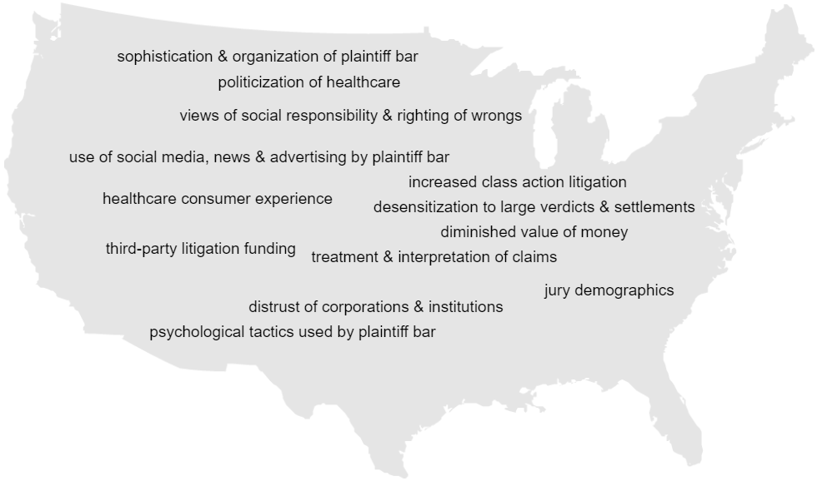
Social inflation
Drivers of claim costs rising above general economic inflation & expected claim development
Economic
Inflation
Aging
Population
Tort Laws
Provider
Consolidation
Private Equity
Investment
Staffing
Crisis
Evolving
Models of Care
Mental
Health
Technology
COVID-19

Slide 13
Economic inflation above historical norms
HCL loss trends historically ~1% > CPI … will higher wage, medical & legal costs drive losses higher?
Source: US Bureau of Labor Statistics, Consumer Price Index for All Urban Consumers (CPI-U) as of 3/30/2023 https://data.bls.gov/timeseries/CUUR0000SA0

Slide 14
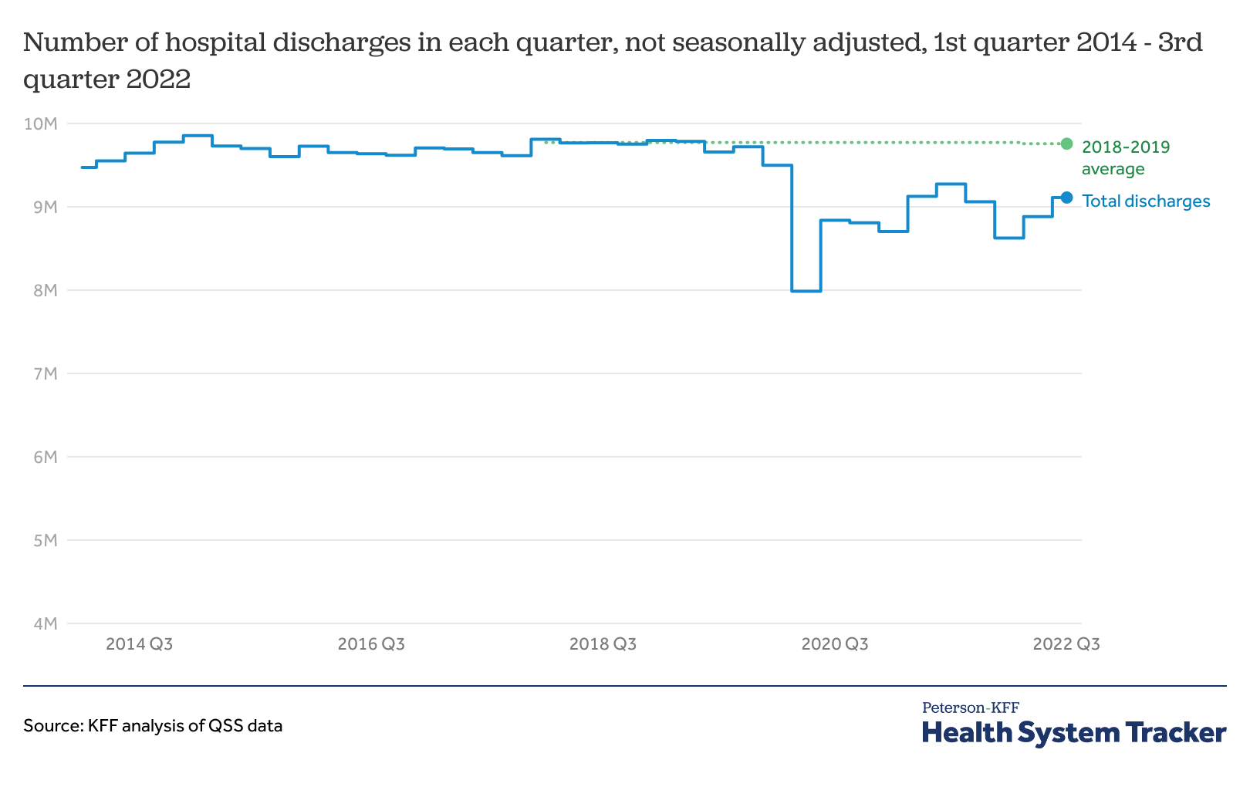
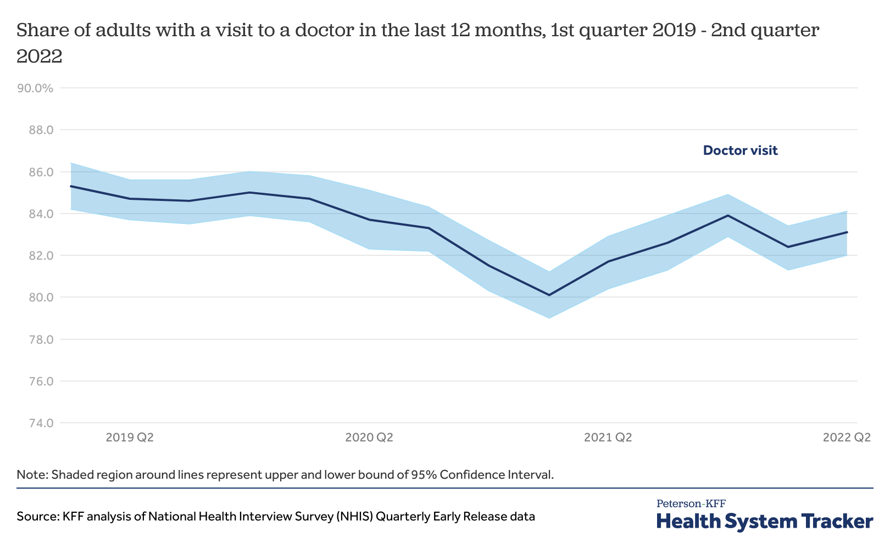
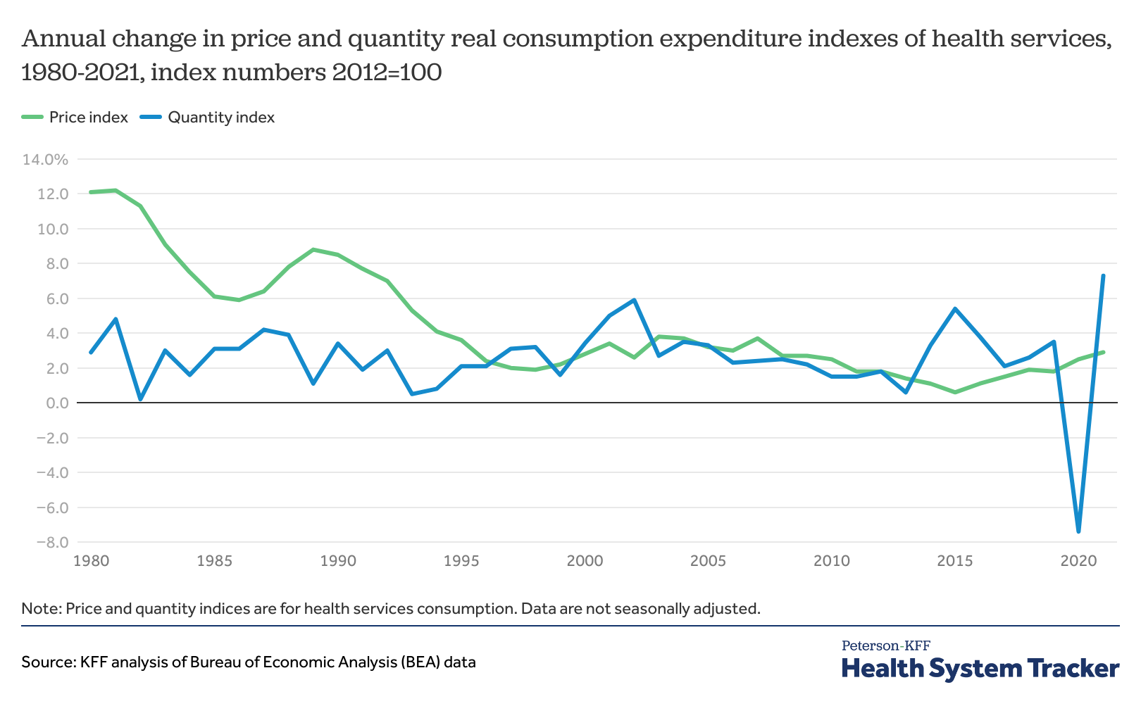
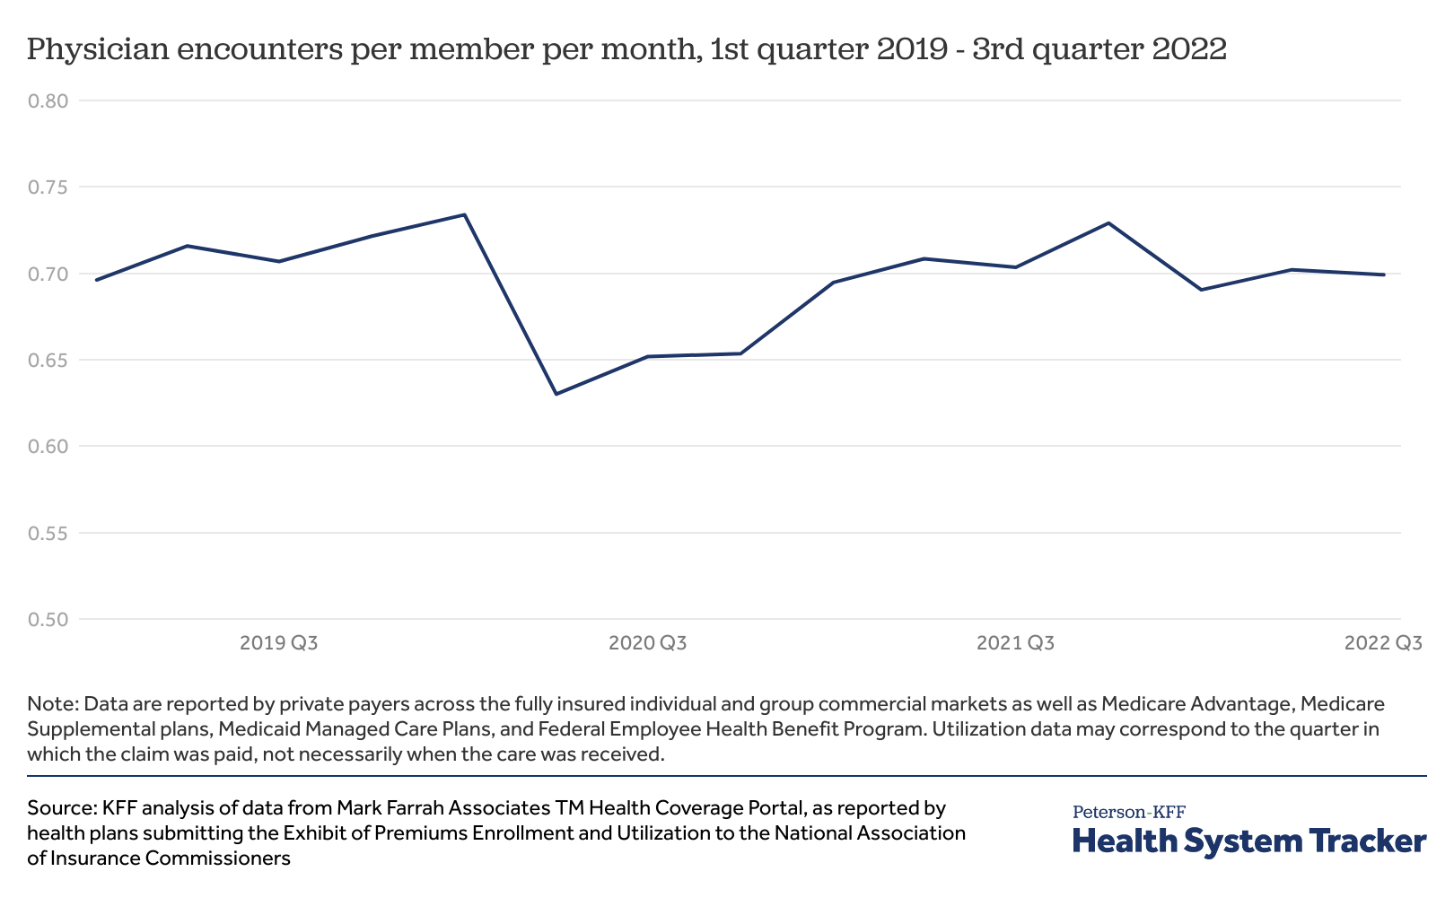
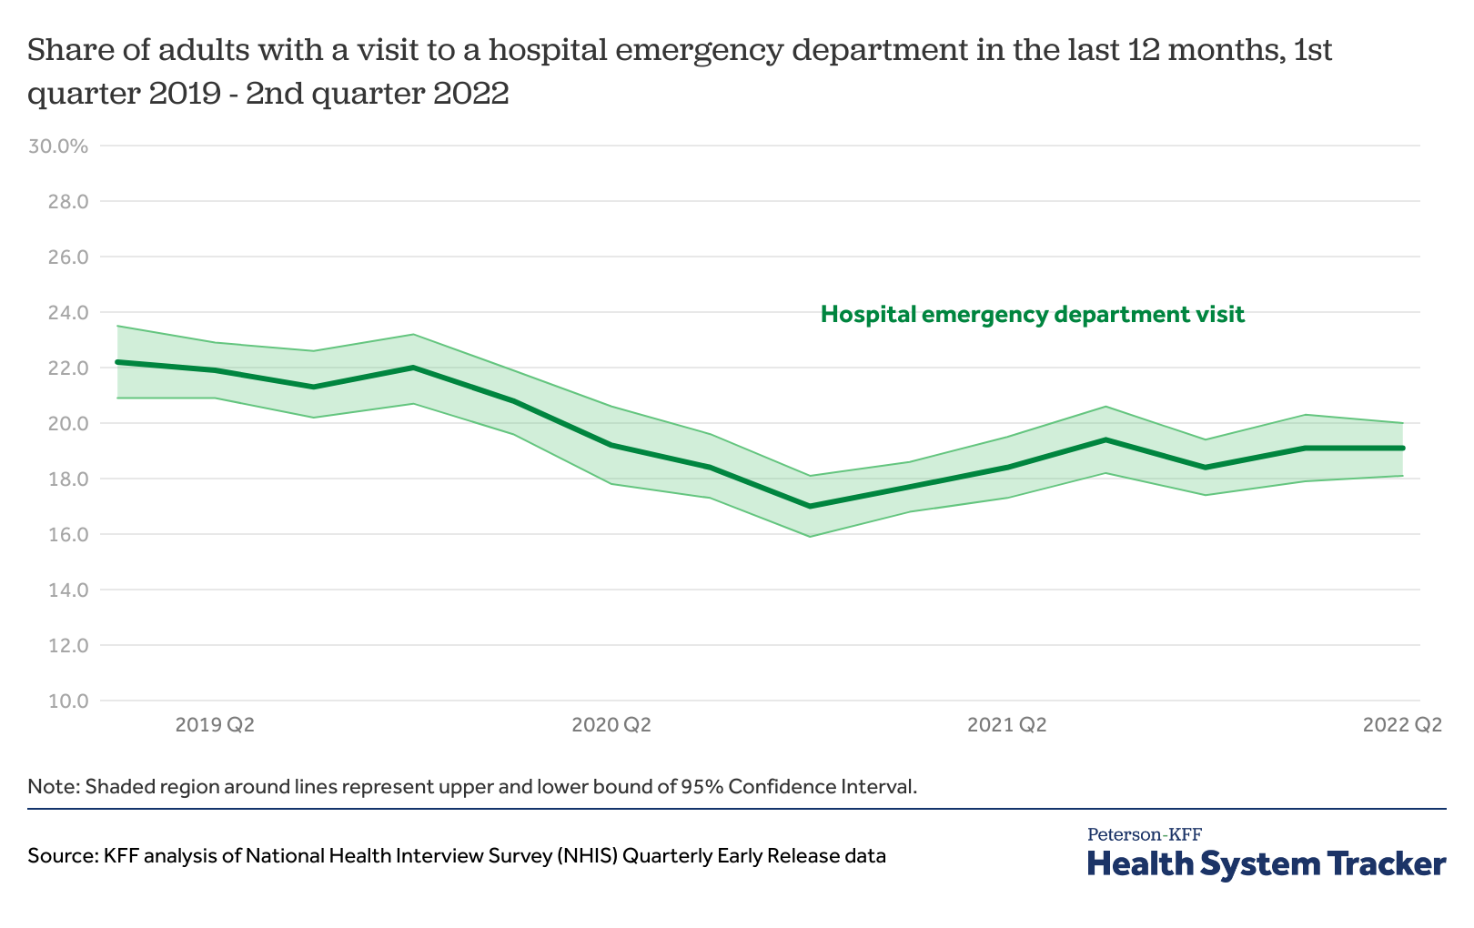
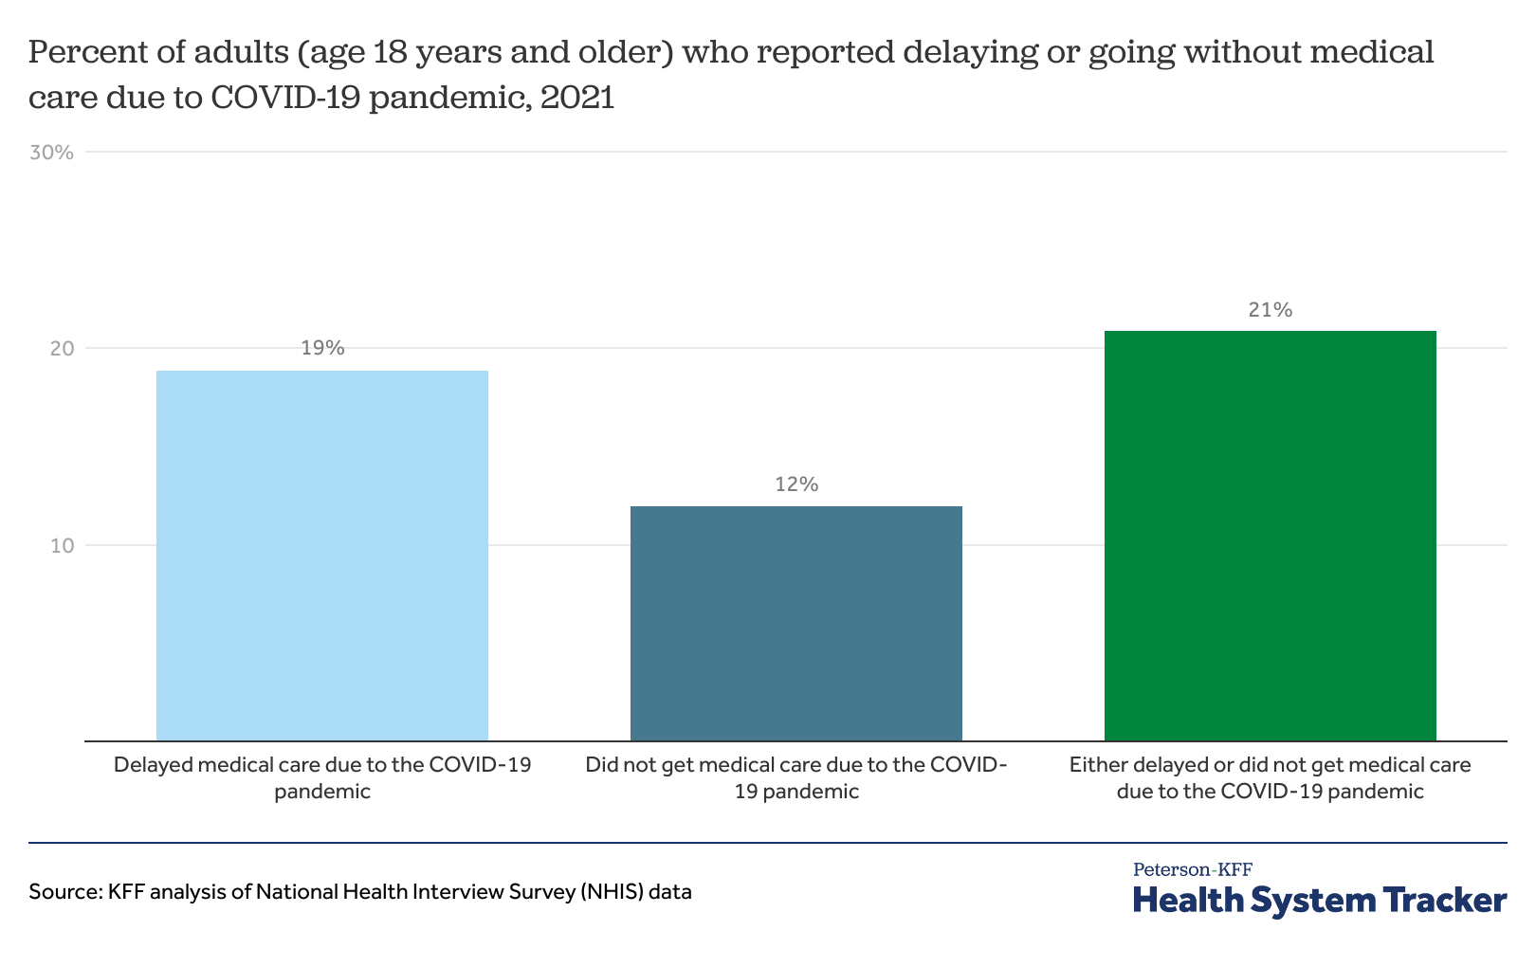
COVID-19 still impacting healthcare utilization
Utilization generally rebounding, but remains below expectations based on pre-pandemic trends
Source: Peterson-KFF Health System Tracker, January 24, 2023

Slide 15
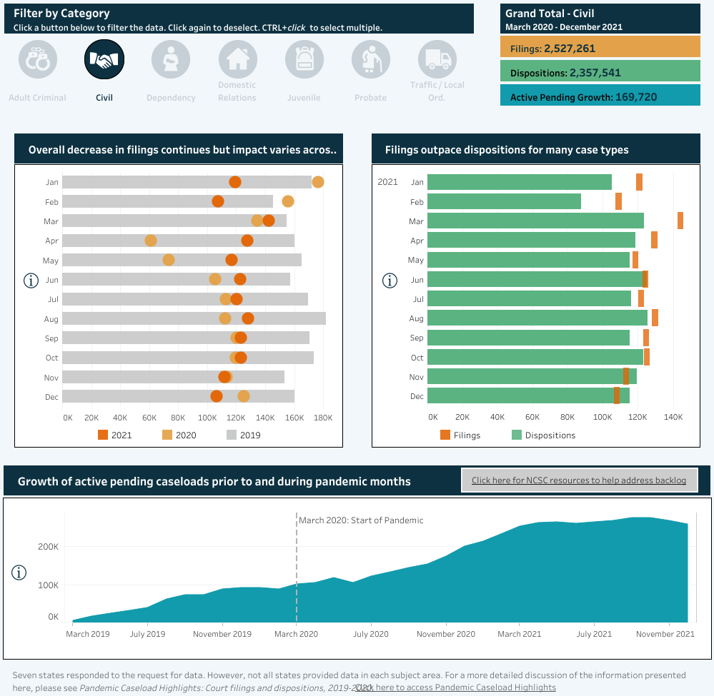
COVID-19 still impacting case filing and resolution
Filings dropped dramatically early in the pandemic and still have not returned to pre-pandemic levels
Case dispositions are lagging behind the still-reduced filings (creating growing backlogs)
Claims data distortions won't be resolved until at least 2025(?)
Source: Court Statistics Project of the National Center for State Courts

Slide 16
Recent change in tort law
IL pre-judgment interest (eff 7/1/21) ... CA MICRA & PA venue rule (eff 1/1/23) ... NY wrongful death (TBD)
IA cap on non-economic damages … FL HB837
Note: CA, IL, NY & PA ~35% of US HCL market (4 of top 6 states based on 2022 DWP)

Slide 17
US HCL industry now consistently underwriting to a loss
Combined ratio > 100% since 2014 … driven primarily by deteriorating claims/litigation environment
Sources: AM Best Aggregate & Averages, S&P Global Market Intelligence. Dividends included.

Slide 18
US HCL industry now consistently underwriting to a loss
Combined ratio > 100% since 2014 … driven primarily by deteriorating claims/litigation environment
Historically, industry response (premium increases > loss trends) lags underwriting losses by several years … and ends at first sign of profitability
Sources: AM Best Aggregate & Averages, S&P Global Market Intelligence. Dividends included.

Slide 19
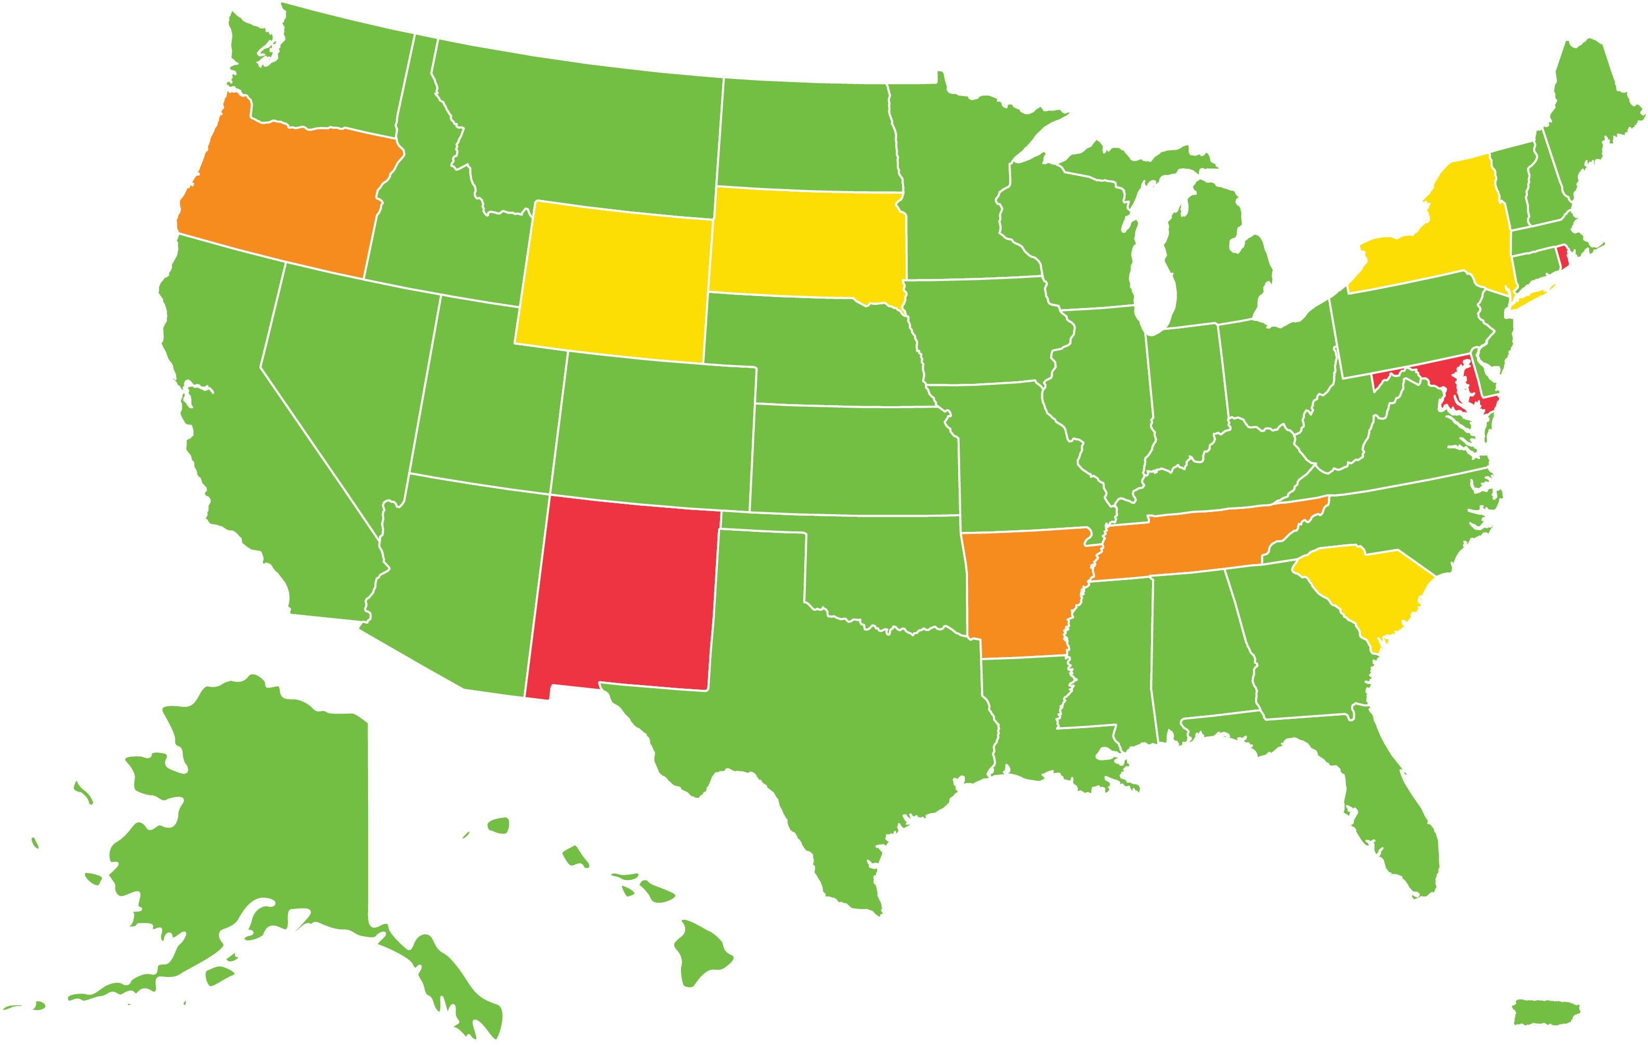
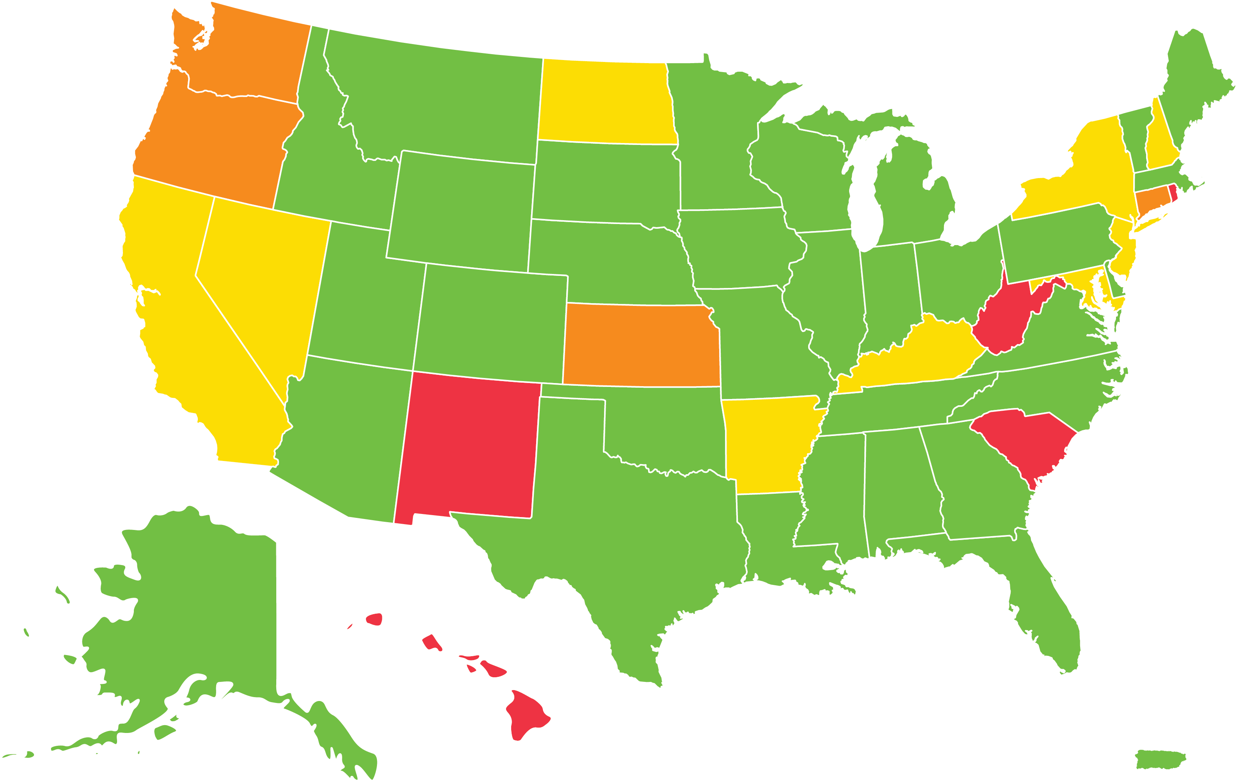
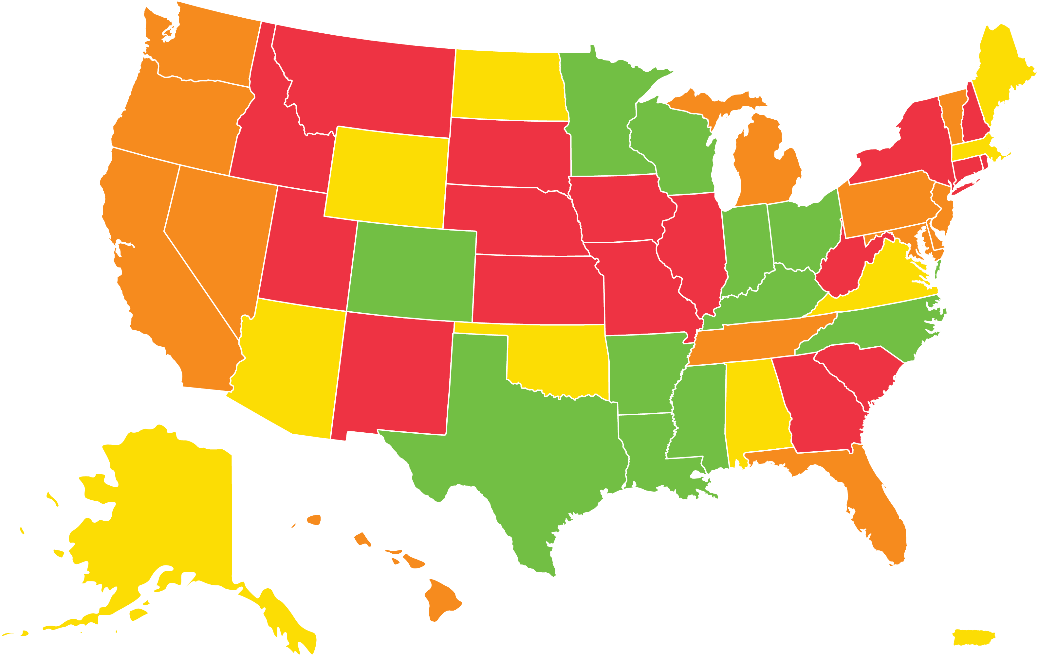
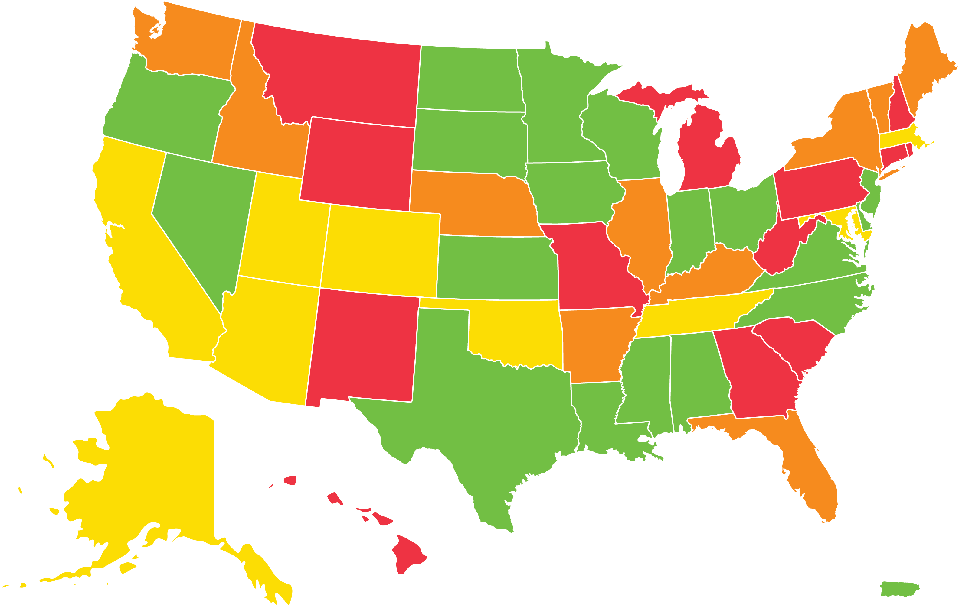
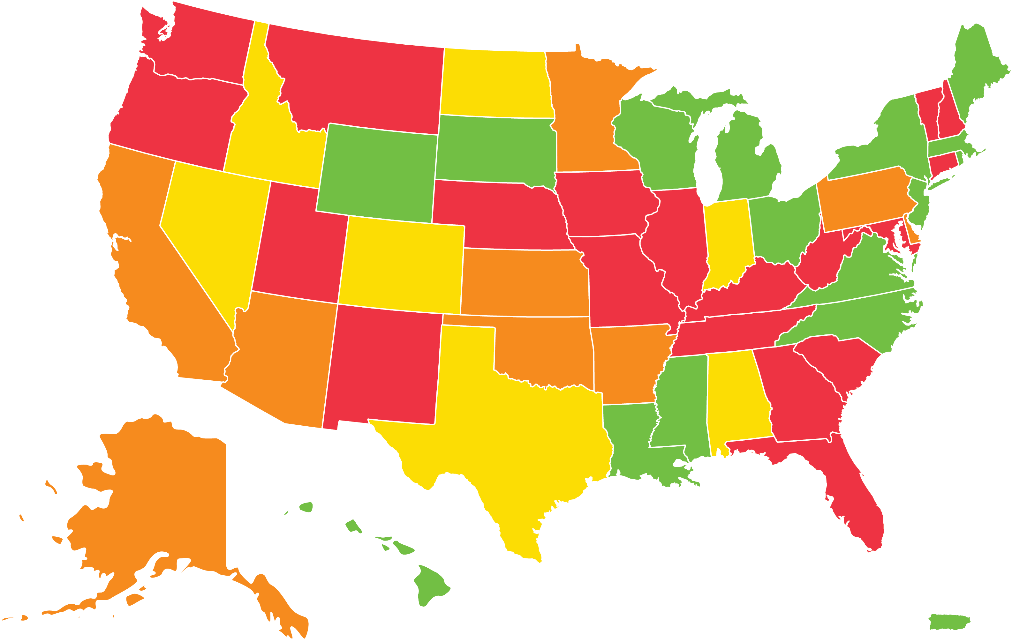
Combined Ratios deteriorating countrywide and in most states
2012-13: 91%
2020-21: 111%
2014-15: 103%
2016-17: 104%
2018-19: 108%
< 95%
95-105%
105-115%
> 115%
Sources: AM Best Aggregate & Averages, S&P Global Market Intelligence. Competitor dividends included.

Slide 20
"Gearing effect" of severity
"Because hospital claims are capped by either the per claim retention or aggregate retention, this gearing effect suppresses the inflationary impact of claims. That means that although inflation appears to be moderate as experienced by the end client, inflation is actually occurring at a higher level for the excess underwriter."
"Underwriters continue to try to quantify the resulting impact."
Source: Beazley article: "Hospital Professional Liability: Today’s Challenges and Tomorrow’s Implications"

Slide 21
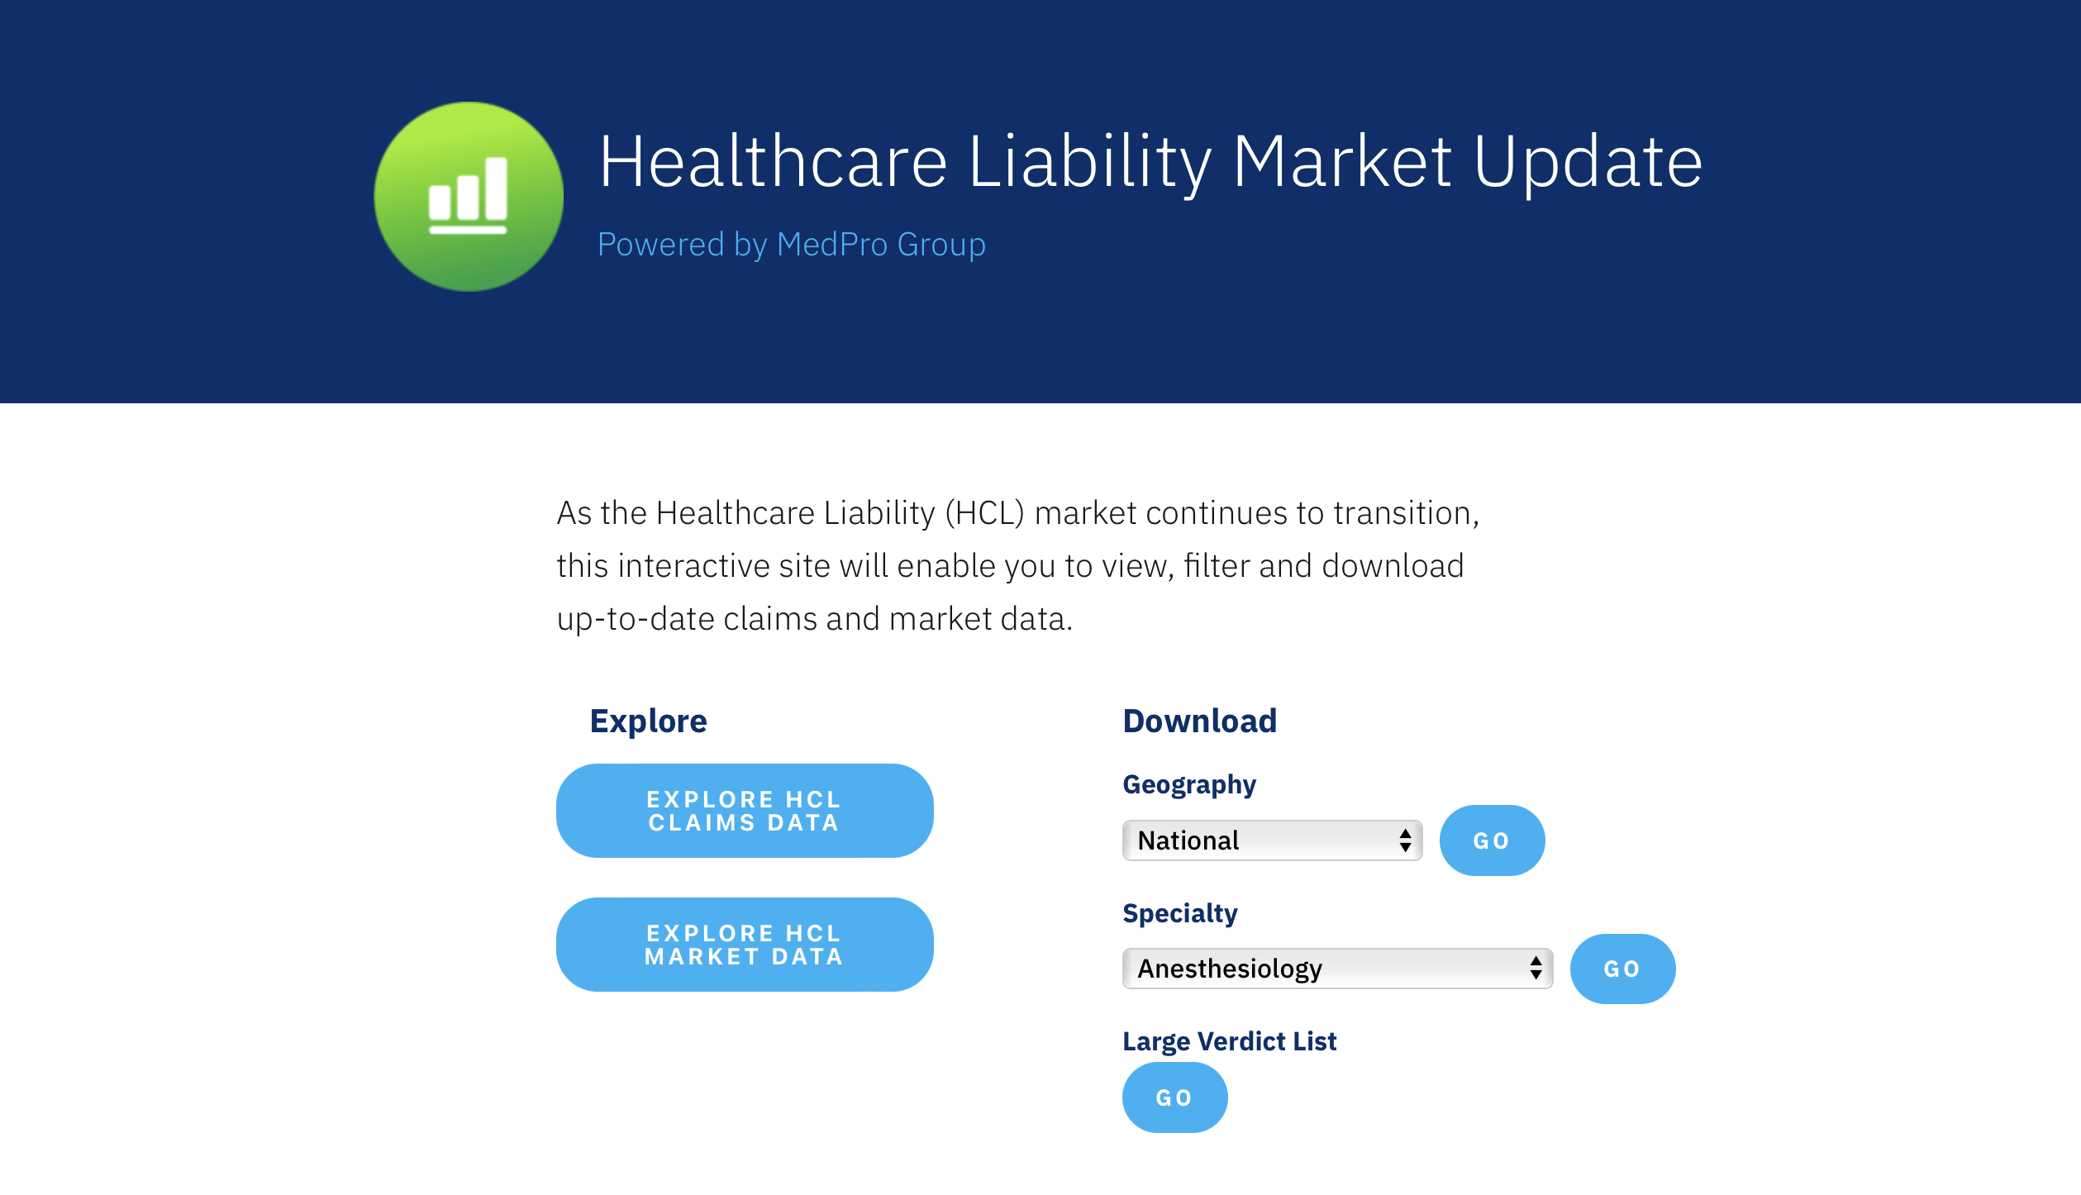
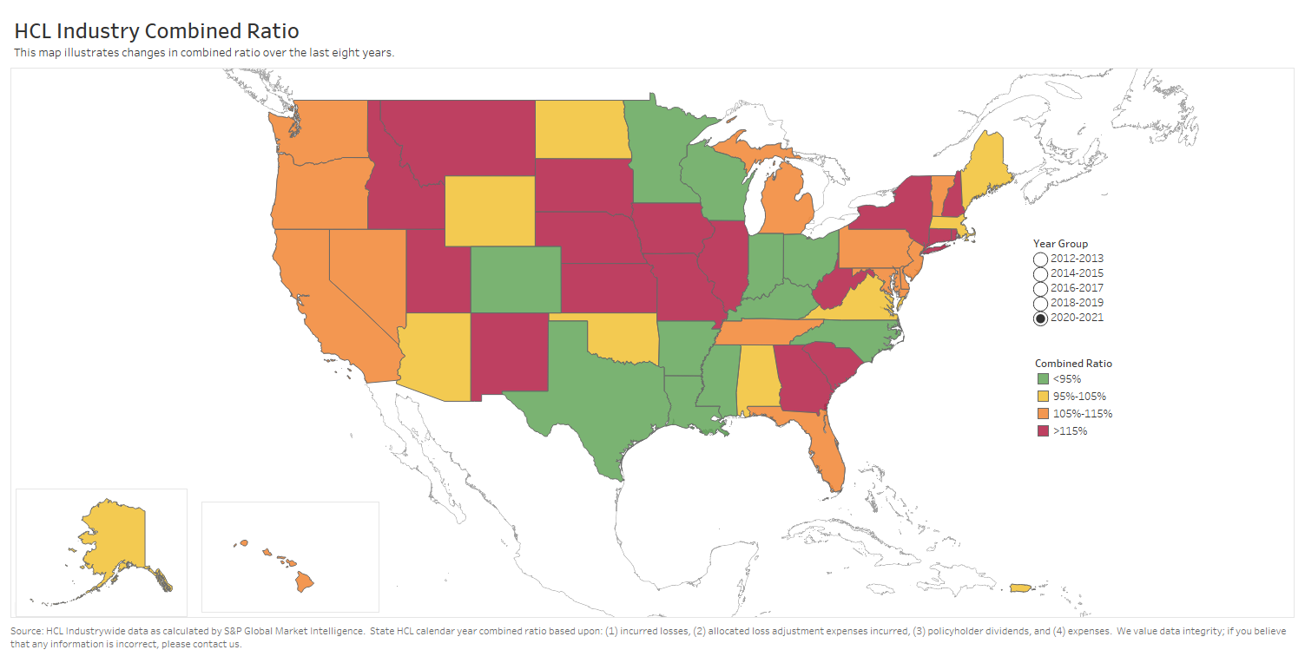
HCLMarketUpdate.com
Claims Data:
Physicians & Surgeons and Additional Professionals
Specialty-specific reports
Severity trend | Indemnity payment ranges | Paid claims & severity trends
Filters: states | years | allegations | outcomes
Large Verdicts
Count by year | Map | List (downloadable)
Market Data:
Direct Written Premium by industry & segment
Combined Ratios by states & insurers
AM Best Ratings by insurer

Slide 22
Call to action
Let's get creative … new ways to drive down the value of claims
Trying more cases
Resolving internal stakeholder disputes (insureds, self-insurers, primary/lead insurers, reinsurers/excess insurers … incl. co-defendants)
Take to trial or settle?
If settle, for how much?
Reasonable people can disagree reasonably – ensure those disagreements don't work to plaintiff's advantage
Other ideas?

